Slide 1
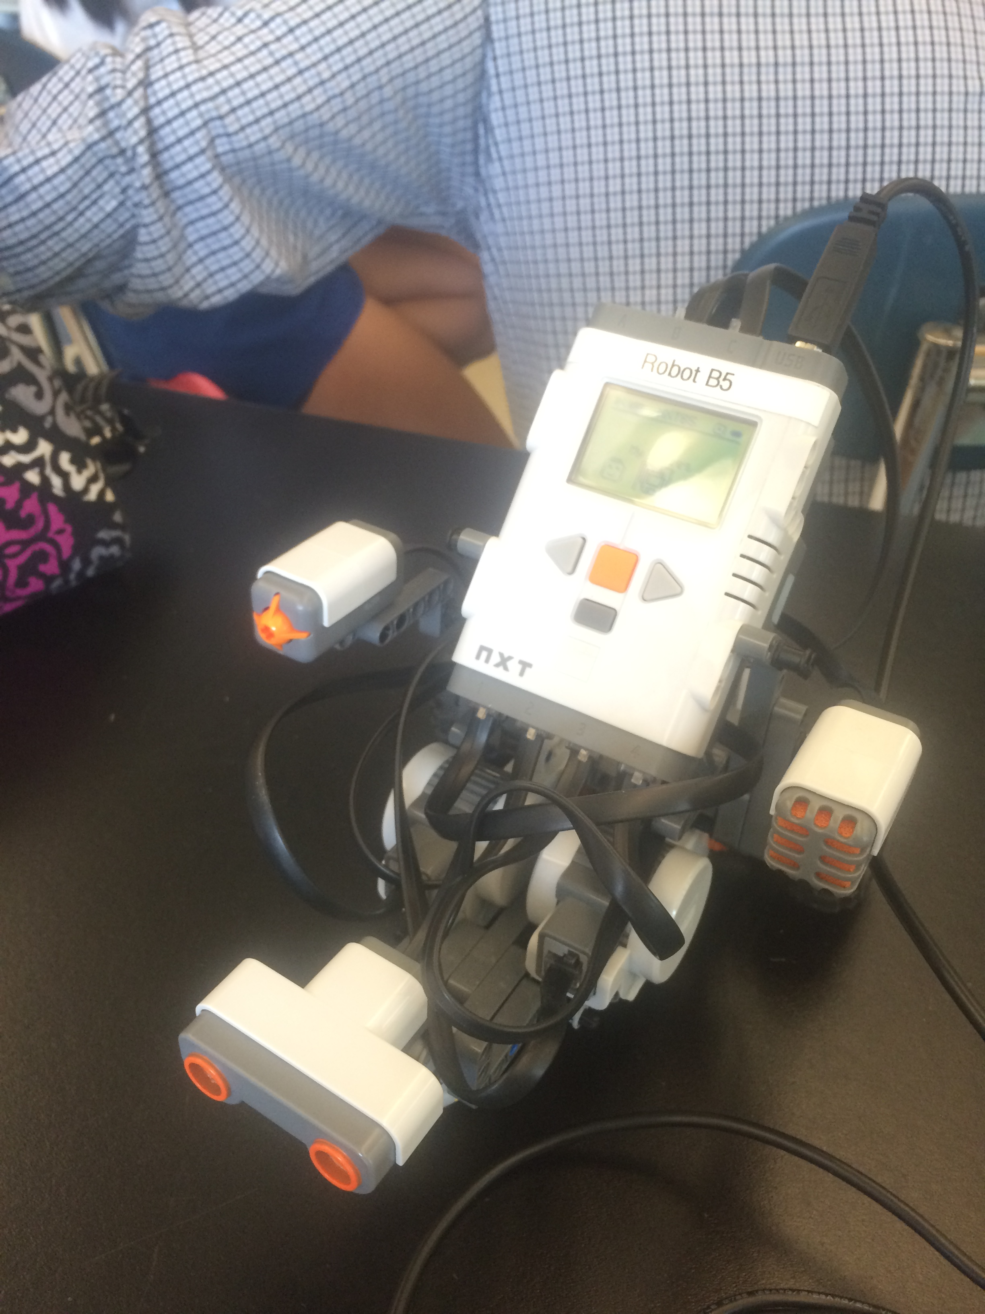
Stem 1b: the mars challenge
Rebecca Sereboff and Isa Layton

Slide 2
Programs: Foreword
Straight for 15 seconds

Slide 3
Programs: Backwards
Backwards straight for 15 seconds

Slide 4
Programs: Turning
Turning 270 degrees

Slide 5
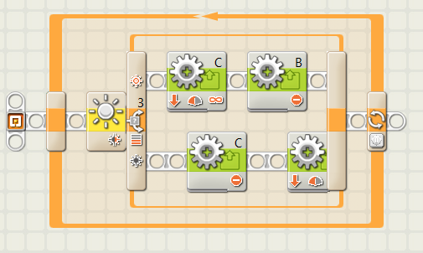
Tracking a curve
Uses the light to find and follow the tape

Slide 6
Various surfaces
We had wheels big enough to get us over what we wanted to get over the rocks
We also had motors and gears big enough for it to go fast enough

Slide 7
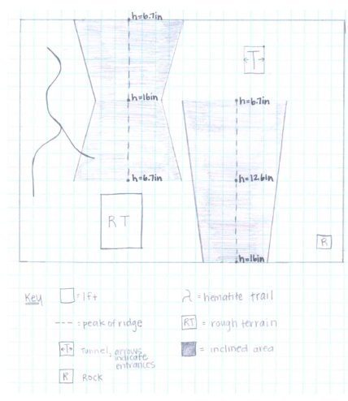
Test stimulations
We had resources available in the classroom that modeled what the challenges would be like on Mars, like the rock, rocky terrain, and hematite trail (see map of ‘Mars’ below).
These helped us realize that we wanted to keep the size of the gears and wheels

Slide 8
Gear and wheel choice
Keep the wheel and gear the same as it was when we received the robot
Not way better and one task than at the other

