Slide 1
Sierpinski Shapes
By Isa Layton and Grace Watts

Slide 2
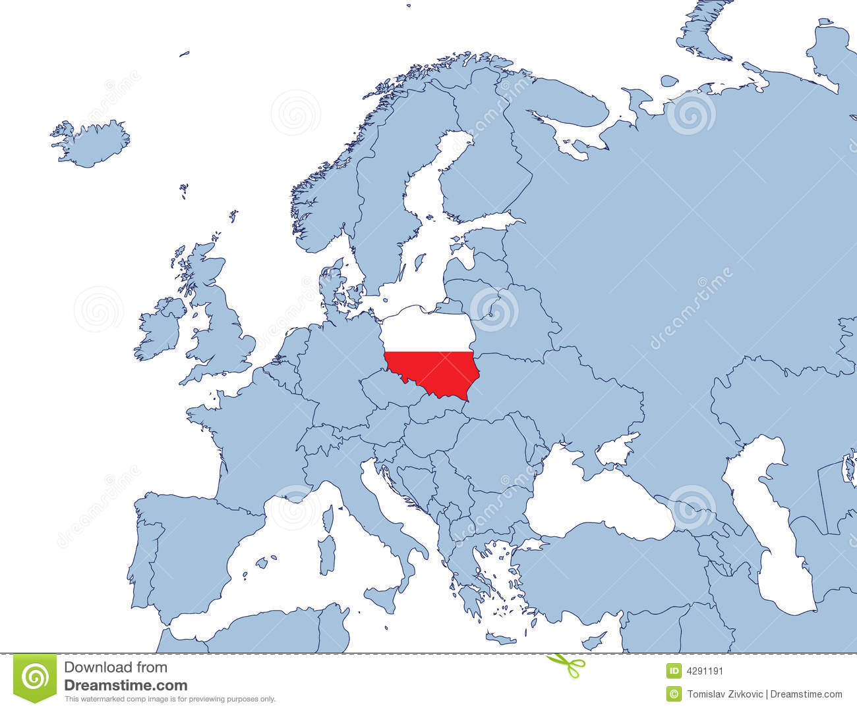
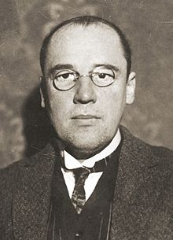
Sierpinski: The Beginning
Watcaw Sierpinski (1882 – 1969) was a polish mathematician

Slide 3
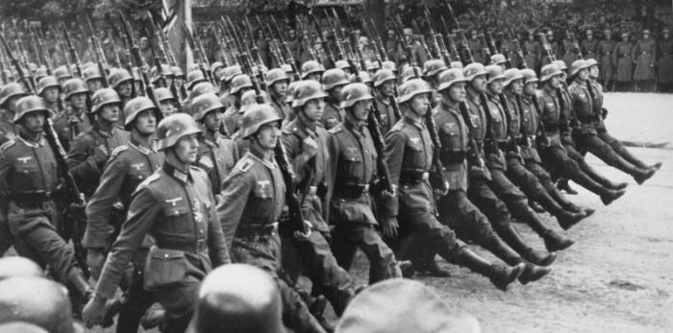
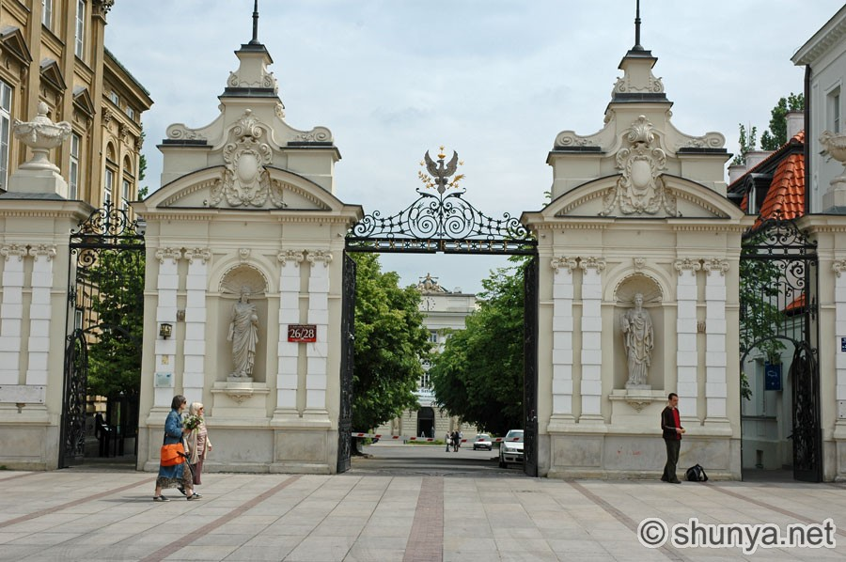
Changing Times
Warsaw University (Class of 1904)
Because of World War One, he saw that a new Polish state could emerge, and a scarcity of books and journals would be scarce
1908 first person to lecture on Set Theory

Slide 4
The Result
Worked with Zygmunt Janiszewski and Stefan Mazurkiewicz on set theory, point set topology, the theory of real functions, and logic (very dangerous work due to the Nazis)
Janiszewski died in 1920, but the other two saw the plan through
After this, Sierpinski worked individually on specifically set theory and topology
600 research papers
100 papers on number theory

Slide 5
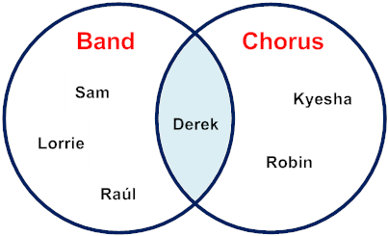
Set Theory
Did not go over in class
Definition: Branch of mathematics that deals with the properties of well-defined collections of objects.

Slide 6
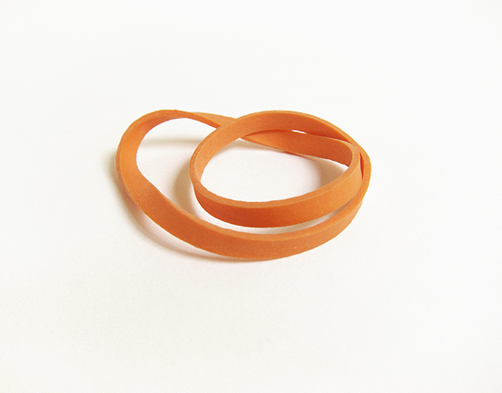
Topology
Work some in class
Definition: the mathematical study of the properties that are preserved through deformations, twistings, and stretchings of objects.
He experimented with this and created different shapes (triangle and square)

Slide 7
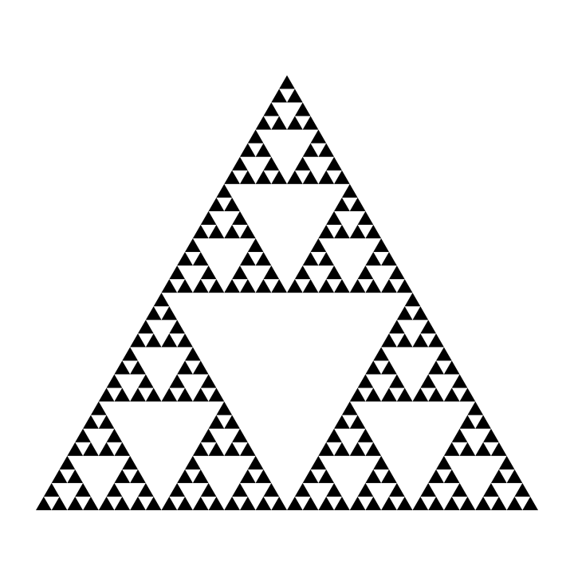
Sierspinski’s Shapes
Sierpinski’s triangle
Carpet

Slide 8
Sierspinksi’s Triangles
a fractal based on a triangle with four equal triangles inscribed in it. The central triangle is removed and each of the other three treated as the original was, and so on, creating an infinite regression in a finite space.

Slide 9
Triangles: Step One
Start with a regular triangle (black here)

Slide 10
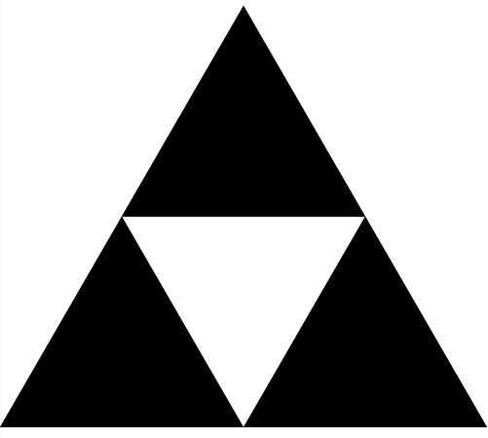
Step Two
Cut out a triangle from inside the original triangle

Slide 11
Step Three
Cut out a triangle from the remaining three black triangles

Slide 12
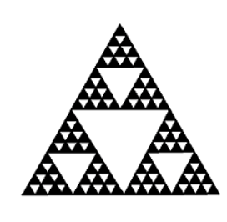
Step Four
Repeat Steps two and three indefinitely

Slide 13
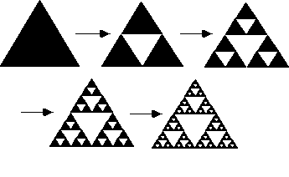
GIFS & Such

Slide 15
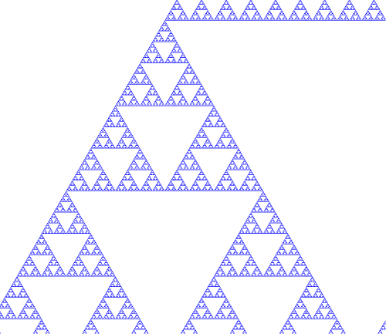

Slide 16
The End! We hope you enjoyed!

Slide 17
Works Cited Page
http://nlvm.usu.edu/en/nav/frames_asid_137_g_4_t_3.html?open=instructions&from=search.html?qt=sierpinski
http://www.shunya.net/Pictures/Poland/Warsaw/Warsaw.htm
http://io9.com/the-8-worst-mistakes-made-by-the-allies-during-world-w-1472602177
http://www.dreamstime.com/stock-image-poland-europe-map-image4291191
http://www.britannica.com/biography/Waclaw-Sierpinski
http://mathforum.org/mathimages/index.php/Sierpinski's_Triangle

Slide 18
Works Cited: Continued
https://en.wikipedia.org/wiki/Wac%C5%82aw_Sierpi%C5%84ski
http://www.britannica.com/biography/Waclaw-Sierpinski
http://mathworld.wolfram.com/Topology.html
http://www.britannica.com/topic/set-theory
http://wallpaper222.com/explore/black-and-white-triangle-logo/
https://plus.maths.org/content/os/issue55/features/kormann/index
http://world.mathigon.org/Fractals
http://math.bu.edu/DYSYS/chaos-game/node2.html

