Slide 1
Stage Gate Evaluation Process
By: Alex, Grace, Isa, and Isabelle

Slide 2
LD50 Constraints
MAX LD50: We want a survival rate of 50%-100% of the ecoli and the other organisms to be tested
Notes:
Isabel Alfriend

Slide 3
SPF Constraints
Max SPF Values:
Oxybenzone- Must be less than 6%
Cinnamate- Must be less than 7.5%

Slide 4
Cost Constraints
Min Cost: $0
Max cost of Package Referenced: $3.00 with glue, $4.00 without glue

Slide 5
Material Constraints
Highest Packing Materials Testing Criteria: multiple tests were run on each of the materials including: drop test, shake test, weight test, throw test, water test and a heat test. The materials were scored on a scale of 1-3 for each test, 3 being no damage, 2 being little damage and 1 being lots of damage.

Slide 6
Cost Analysis
Cost Analysis of Sunscreen Materials: cin- $.067 per ounce, oxy- $.08 per mL
Cost of Recommended SPF Formula:
Preliminary Cost of Package: (2)cardboard- $1.00, (2)plastic bags- $.25, budget with glue- $3.00, total price- $2.50
Notes:
Alex Rubin

Slide 7
Maximum Amount Allowed (MSDS)
Cinnamate
Maximum Allowed: 7.5% of the total (.387 ounces)
Oxybenzone
Maximum Allowed: 6% of the total (.0376 grams)
Notes:
Isa Layton
Overview of MSDS information
Graph/Visual Representation of LD50 Data
Conclusions from LD50 Data

Slide 8
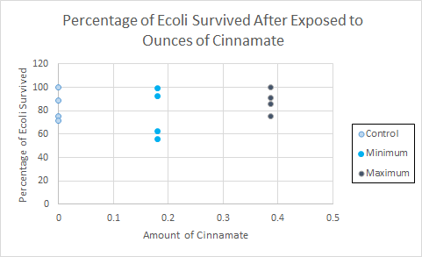
Graph of Survival with Cinnamate

Slide 9
Conclusion: Cinnamate
We could use:
The Control Amount (0)
The Minimum Amount (.18 oz)
The Maximum Amount (.387 oz)
We could use any of the amounts listed above, because in none of the cases were 50% or more of the Ecoli killed.

Slide 10
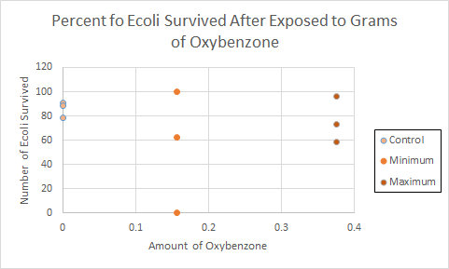
Graph of Survival with Oxybenzone

Slide 11
Conclusion: Oxybenzone
We could use:
The Control Amount (0)
The Minimum Amount (.0157g)
The Maximum Amount (.0376g)
We could use any of the amounts listed above, because none of them killed 50% or more of the Ecoli.

Slide 12
Future Work
In the future, we would want to re-run the tests (our data was not what we or the teachers expected). We would also be interested in varying the amount of Cinnamate and Oxybenzone between 0 and .387 and 0 and .0376 respectively. We would also run the test more times (we only ran it once or twice) to get a more complete picture of the data and its consequences.
Notes:
ALL - Recommendations for Formula Mix

Slide 13
Materials used for package
2 cardboard pieces
used for structure and protection of the lotion
3 plastic bags
- used for protection against water and to hold the lotion inside of the structure
Glue
-used to hold everything together

Slide 14
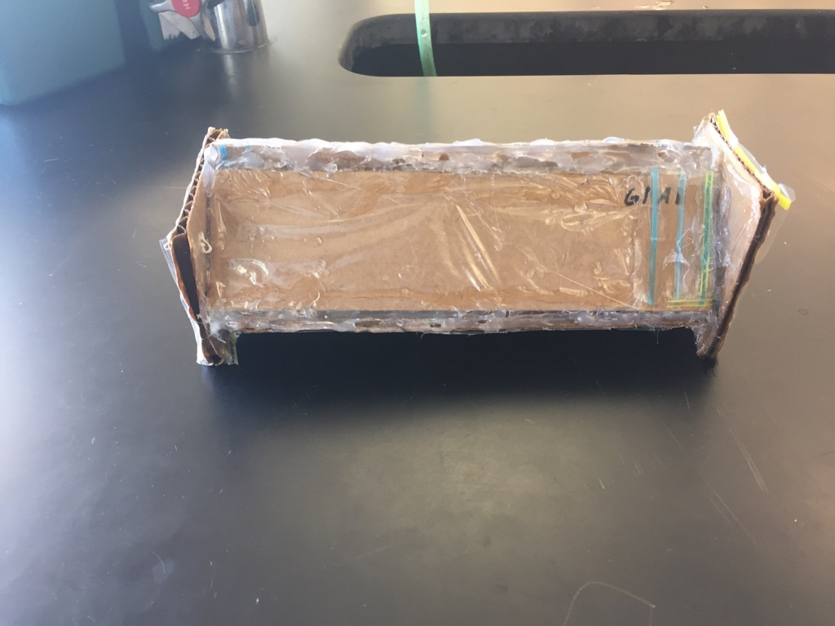
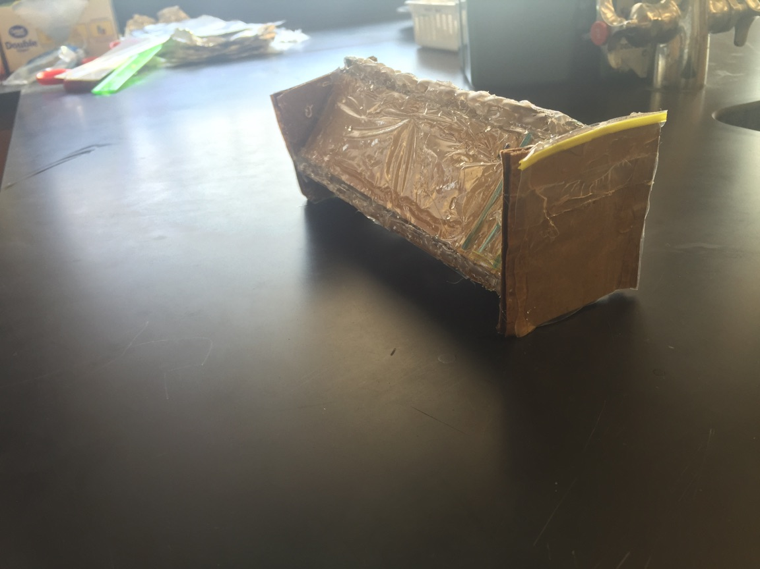
Package design

Slide 15
Product Testing
Drop test (no damage) 3/3
Shake test (a bit of glue came off) 2/3
Throw test (lotion bag inside broke on the last throw) 1/3
Heat test (no damage) 3/3
Water test (no damage) 3/3

Slide 16
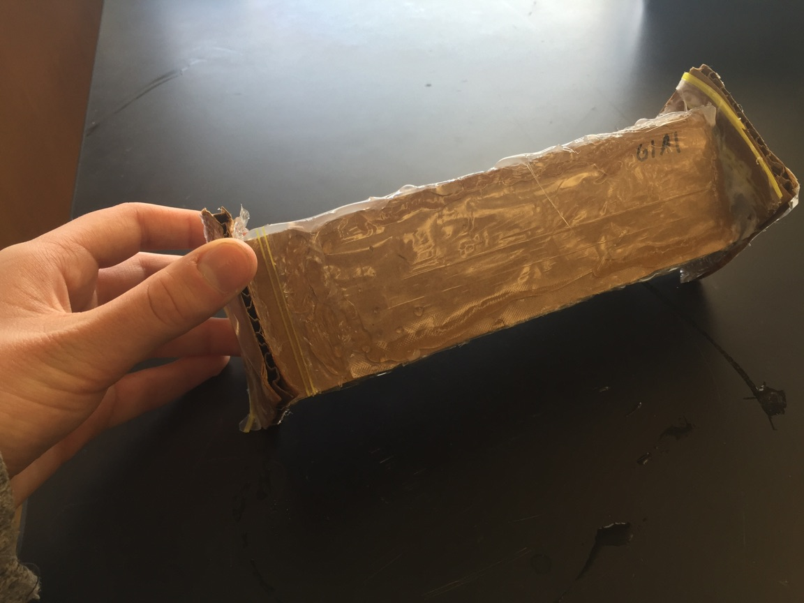
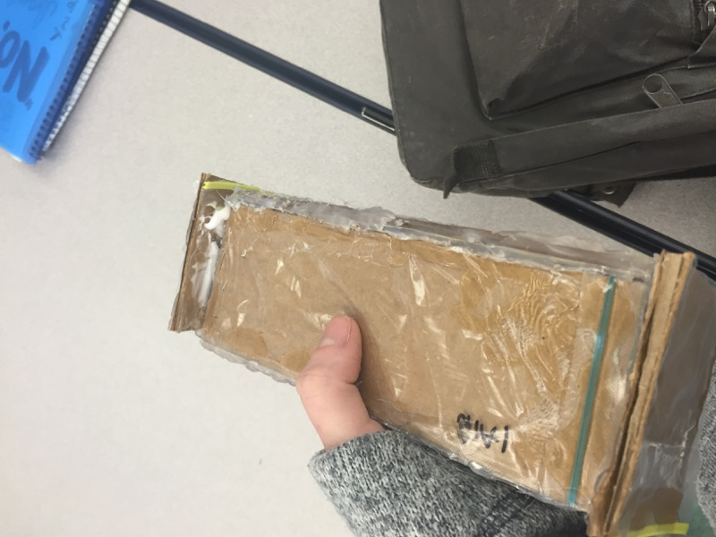
Results of testing
Shake test Drop test

Slide 17
Recommendations For Formula Mix
Oxy-Benzone: Less than and including 5.55 grams
Cinnamate: Less than and including 7.05 grams
Total 12.745%

Slide 18
The End! Thank you for watching!
STEM IIB ~ 2016 ~ Class of 2018

