Slide 1
Mobius Strips
Kennedy Manley and Ally Osten

Slide 2
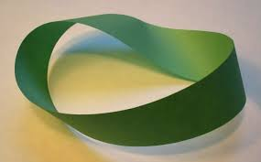
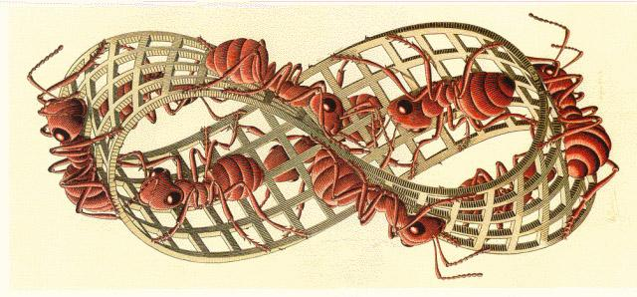
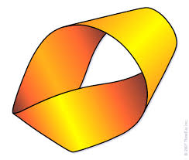
What is a Mobius strip?
The Möbius strip, is also called the twisted and it is a one-sided nonorientable surface. It is made by cutting a closed band into a single strip and giving one of the ends a half twist. Then, you reattach the two ends.

Slide 3
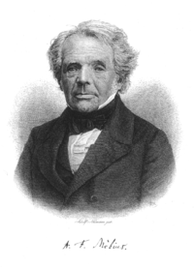
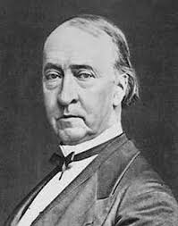
August Ferdinand Mobius and johann benedict listing
They both came up with the Mobius strip individually in 1858
Both were German mathematicians

Slide 4
Mobius strip characteristics
A surface with only one side and one boundary
Non-orientable
A model can easily be created by taking a paper strip and giving it a half-twist, and then joining the ends of the strip together to form a loop
The Euler characteristic is zero
Notes:
Non orientable means you can not determine/acknowledge a difference between the two sides; since there is only one side of a Mobius strip.

Slide 5
Equations
Notes:
This parameterization is based on the topological definition of a Möbius strip as the rotation of a line segment around a circle, with half twist. a is the radius of the circle about which the line is rotated, u is the angular position around the circle of the segment, and v is the position along the horizontal line.

Slide 6
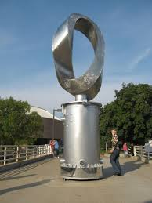
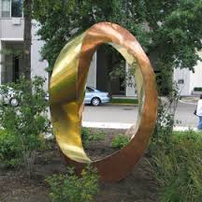
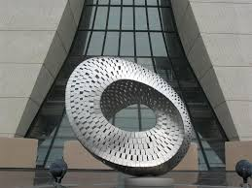
How are Mobius Strips used in everyday life?
Artwork:

Slide 7
Escher’s art

Slide 8
The recycling sign

Slide 9
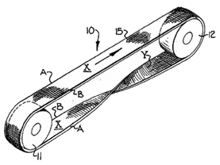
Conveyor Belts

Slide 10
Bagels can be cut “Mobiusly”

Slide 11
Mobius Strip Predictions and Explorations
# of twists | # of sides | Kind of Cut | Prediction | Results
 |  |  |  | Width | # of loops | length
0 | 2 | 1/2 | It will make two cylinders | 1/2 2 the same
1 | 1 | 1/2 | One Large Loop | ½ 1 double
1 | 1 | 1/3 | Two Loops | 1/3 2 Double/The Same
2 | 2 | 1/2 | Two loops each with a twist | 1/2 2 the same

Slide 12
More explorations of Mobius strips
half-twists cuts divs. result
1 1 2 1 band, length 2
1 1 3 1 band, length 2
1 Möbius strip, length 1
1 2 4 2 bands, length 2
1 2 5 2 bands, length 2
1 Möbius strip, length 1
1 3 6 3 bands, length 2
1 3 7 3 bands, length 2
1 Möbius strip, length 1
2 1 2 2 bands, length 1
2 2 3 3 bands, length 1
2 3 4 4 bands, length 1

Slide 13
Relation to Klein Bottles
Notes:
A clever limerick we found relating klein bottles to Mobius strips. Klein bottles are two Mobius strips put together.

Slide 14
Klein bottle into Mobius strip transformation
Notes:
This picture shows how a klein bottle transforms from a solid into two different Mobius strips.

Slide 15
https://www.youtube.com/watch?v=NRvK_07KRV8

Slide 16
Bibliography
https://en.wikipedia.org/wiki/Michael_Atiyah
http://www.rossmartinmd.com/creations_mobius.htm
https://en.wikipedia.org/wiki/August_Ferdinand_M%C3%B6bius
http://www-history.mcs.st-and.ac.uk/Posters/725.html
http://www.artparks.co.uk/artpark_sculpture.php?sculpture=6582&sculptor=plamen_yordanov
http://blog.msubbu.org/2013/07/the-mobius-strip-in-art-and-design.html
http://fineartamerica.com/profiles/plamen-yordanov.html
http://www.mpcity.net/index.aspx?NID=142
http://skeptics.stackexchange.com/questions/12260/do-m%C3%B6bius-strip-conveyor-belts-last-longer
http://static.digg.com/images/03bf67904c394d5696297f034ba2bdbc_d3c9f68c520e4a68bca142d79173cc1f_header.jpeg
http://www.georgehart.com/bagel/bagel.html
https://www.math.ksu.edu/~muenz/560/Mobius%20Strips%20and%20Klein%20Bottles.pdf
http://im-possible.info/english/articles/klein-bottle/
http://mathworld.wolfram.com/MoebiusStrip.html
https://www.math.hmc.edu/~gu/curves_and_surfaces/surfaces/moebius.html

