Slide 1
Exploring Mars
By: Emma Shaw and Keziah Palmer

Slide 2
challenge to traverse Mars using
Two students were given the
the Lego Mindstorm NXT robots…

Slide 3
With the odds against them they set
fourth to complete this task.
Here is their preparation…

Slide 4
Forward Program
This program allowed them to go forward over regular surfaces.
Block 1-Starts motor C to go forward
Block 2-Starts motor B to go forward
Block 3- Tells the wheels to rotate for 2160 degrees
Block 4- Tells motor C to stop
Block 5- Tells motor B to stop

Slide 5
Backward Program
This program allowed them to go backward over regular surfaces.
Block 1-Starts motor C going backwards
Block 2-Starts motor B going backwards
Block 3- Tells the wheels to rotate for 2160 degrees
Block 4- Tells motor B to stop
Block 5- Tells motor C to stop

Slide 6
Swing Turn Program
This program allowed them to 180 degree swing turn to the right.
(They would edit the amount of degrees to increase or decrease the length of the turn.)
Block 1-Starts motor C going forward
Block 2-Starts motor B going backward
Block 3- waits for motor B to rotate 405 degrees
Block 4- Tells motor C to stop
Block 5- Tells motor B to stop

Slide 7
Point Turn Program
This program allowed them to make a 270 degree point turn to the right.
(They would edit the amount of degrees to increase or decrease the length of the turn.)
Block 1-Starts motor C going forward
Block 2-Starts motor B going backwards
Block 3- waits for motor C to rotate 720 degrees
Block 4- Tells motor C to stop
Block 5- Tells motor B to stop

Slide 8
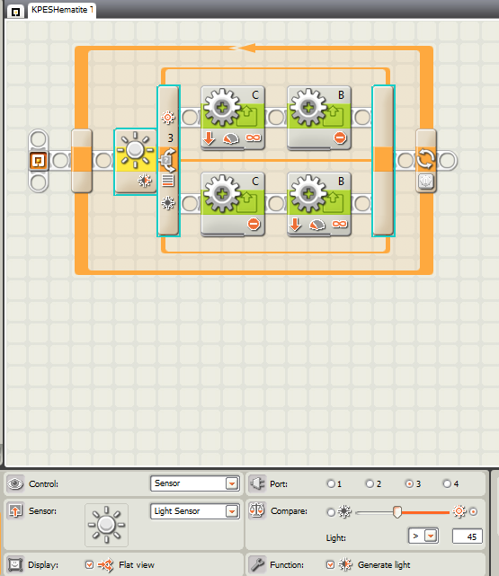
Tracking Hematite Trail
This program was designed so that they would be able to track/ follow a Hematite Trail while on Mars.
Block 1- Activates the light sensor and detects which way the robot will go
Block 2-Tells motor C to go backwards
Block 3- Tells motor B not to move
Block 4- Tells motor C not to move
Block 5- Tells motor B to go backwards
Block 6- Tells the robot to continue repeating blocks 1-5 for 200 seconds before the program stops

Slide 9
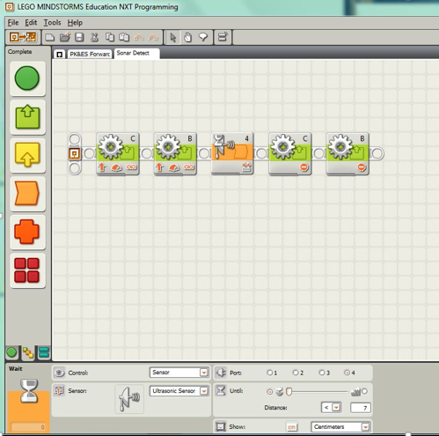
Exploring the Rock
They created this program so they would be able to explore the rock and get within a ½cm from the rock using the robots ultrasonic sensor.
Block 1- Starts motor C and has it go forward repeatedly
Block 2- Starts motor B and has it go forward repeatedly
Block 3- tells the robot that when it senses (using the ultra sonic sensor) an object that is within 7 cm it should activate the next block
Block 4- Tells motor C to stop
Block 5- Tells motor B to stop

Slide 10
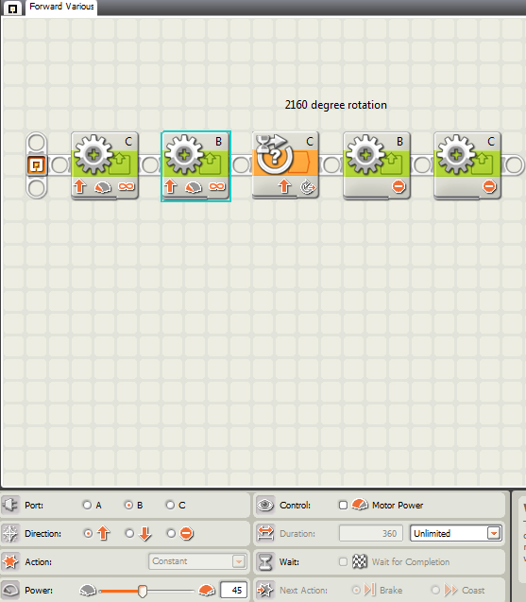
Traversing Various Surfaces
They lowered the power level on the program to allow the robot to travel over rocky or unsmooth surfaces successfully.
Block 1-Starts motor C to go forward at a power of 45
Block 2-Starts motor B to go forward at a power of 45
Block 3- Tells the wheels to rotate for 2160 degrees
Block 4- Tells motor C to stop
Block 5- Tells motor B to stop

Slide 11
Their plan to traverse inclined and declined surfaces was..
They would use their forward to go over any inclined or declined surfaces they would have encountered on Mars.

Slide 12
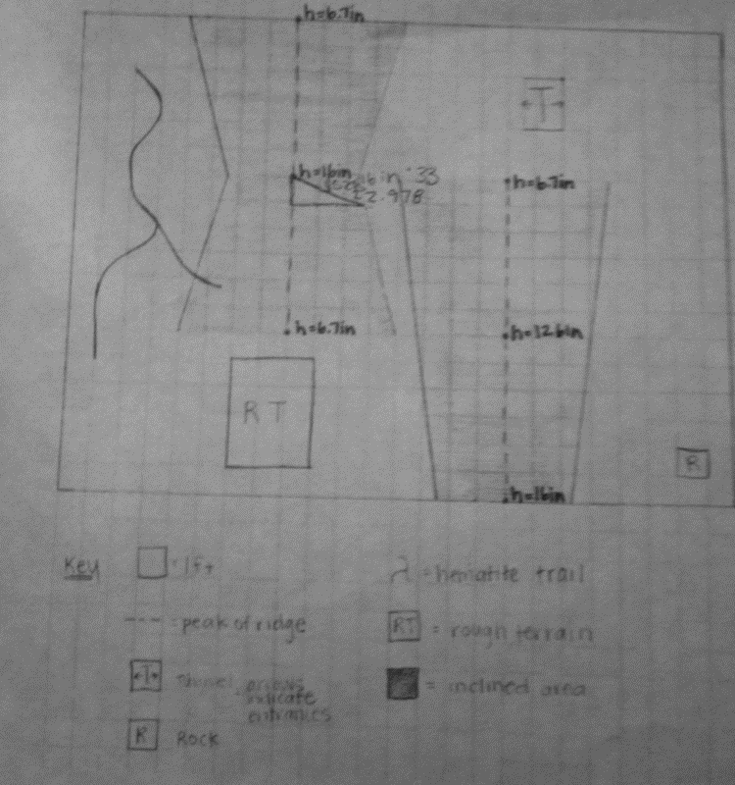
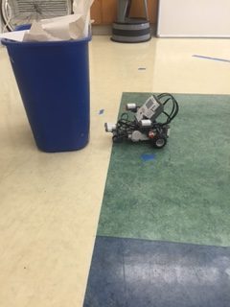
They used these programs and a map of mars which they found using advanced technology (Ms. Popp and Ms. Radov) to create test stimulations in the laboratory. In which they created a similar scenario to what they might encounter.
We used a recycling bin to create a test scenario of exploring the rock.
Map of Mars

Slide 13
and practicing in their
After creating these programs
laboratory, they set off to
These were their results…
Mars.

Slide 14
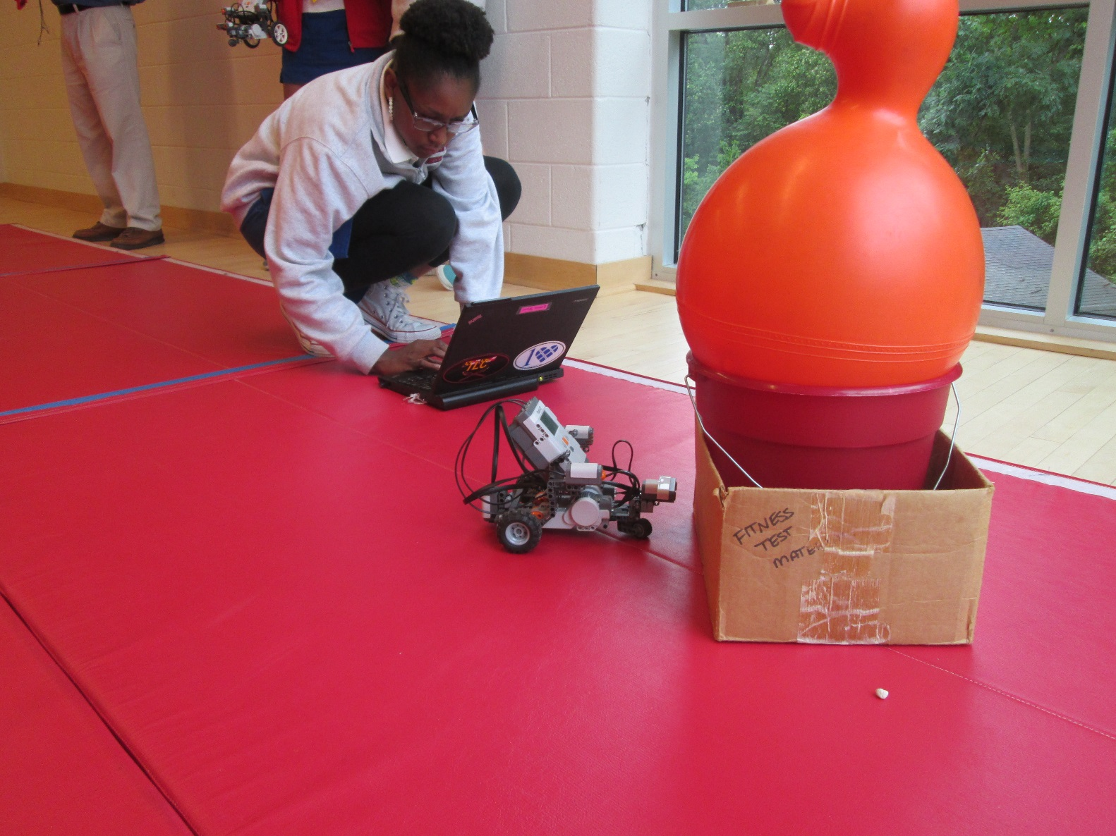
Their robot landed close to the rock which they were able to successfully explore …

Slide 15
They then traveled towards the tunnel which they aligned the robot with and effectively went through..

Slide 16
They then travelled across Mars and encountered rough terrain which they navigated and traveled through…

Slide 17
Finally they found a hematite trail which they were able to navigate and follow using their Hematite Trail Tracking Program.

Slide 18
Thanks to their meticulous planning and
creating of the programs which they
then able to put into effect on Mars, the
students were able to successfully
navigate and explored the Red planet!

