Slide 1
SPF Stage Gate
By Payton bennett, Keziah palmer, hyo shin, jaden kielty

Slide 2
Cost analysis of sunscreen materials
Ethylhexylmethoxycinnamate:
1 ml = $.063 – Source= www.makingcosmetics.com
Based on our data:
The maximum allowed in the sunscreen: 7.5%
7.05 grams of cinnimate – cost: $0.44
The middle amount allowed in the sunscreen: 3.75%
3.525 GRAMS OF cinnimate – cost: $0.22
The minimum amount allowed in the sunscreen: 0%
0 grams of Cinnimate - Cost: $0.00
BENZOPHENONE-3:
1 GRAM= $0.142- SOURCE= WWW.MAKINGCOSMETICS.COM
BASED ON OUR DATA:
THE MAXIMUM ALLOWED IN THE SUNSCREEN: 6%
5.53 GRAMS OF OXYBENZONE- COST: $0.79
THE MIDDLE AMOUNT ALLOWED IN THE SUNCREEN: 3%
2.77 GRAMS OF OXYBENZONE- COST: $0.39
THE MINIMUM AMOUNT ALLOWED IN THE SUNSCREEN: 0%
0 GRAMS OF OXYBEZONE- COST: $0.00

Slide 3
Preliminary cost of package
Cost restriction: $3.00 with use of glue and $4.00 without use of glue
Our materials:
Total of preliminary package: $3.25
-$0.25 remaining cost unused
Materials | Unit Cost | Number of Units used | Cost of Materials for Our Package
Plastic Baggies | $0.25/each | 3 | $0.75
Cardboard | $1.00/each | 2 | $2.00
Hot Glue | -- | -- | --
Tape | $0.50/2.5 cm. | 1 | $0.50

Slide 4
Visual representation of initial material findings
Damage tests on scale from 0(MOST DAMAGED) to 3 (LEAST DAMAGED)
Material | Drop test | Shake test | Weight test | Throw test | Water test | Heat test | marketing | Environmental test
foil | 2 | 2 | 3 | 2 | 3 | 3 | 2 | recycle
Wax paper | 3 | 2 | 3 | 3 | 3 | 3 | 2 | No recycle
Duct tape | 3 | 3 | 3 | 3 | 2 | 3 | 2 | No recycle
Masking tape | 3 | 3 | 3 | 3 | 3 | 3 | 2 | No recycle
Plastic wrap | 2 | 2 | 3 | 2 | 3 | 3 | 1 | No recycle
Plastic bag | 3 | 3 | 3 | 3 | 3 | 3 | 2 | No recycle
cardboard | 3 | 3 | 3 | 2 | 2 | 3 | 2 | recycle
Newspaper | 2 | 2 | 3 | 2 | 1 | 3 | 1 | recycle

Slide 5
Material analysis
Environmentally friendly materials: foil, cardboard, newspaper
Waterproof: foil, wax paper, masking tape, plastic wrap, plastic bag
We found that cardboard, plastic bag and hot glue were most durable and cost efficient.

Slide 6
Justification of materials chosen for package
We first chose to use a plastic bag to seal the lotion in so that it would be contained and not explode or get into the package surrounding it to damage it.
We chose to use cardboard as the main foundation of the package because we found it to be the most sturdy when doing testing
we put the cardboard in a rectangle shape in order for it to withstand tests better like putting five textbooks on top of it.
We then chose to wrap the cardboard box in plastic bags on the outside in order to keep the cardboard dry if the package were to get wet which seemed to be the hardest test against the package

Slide 7
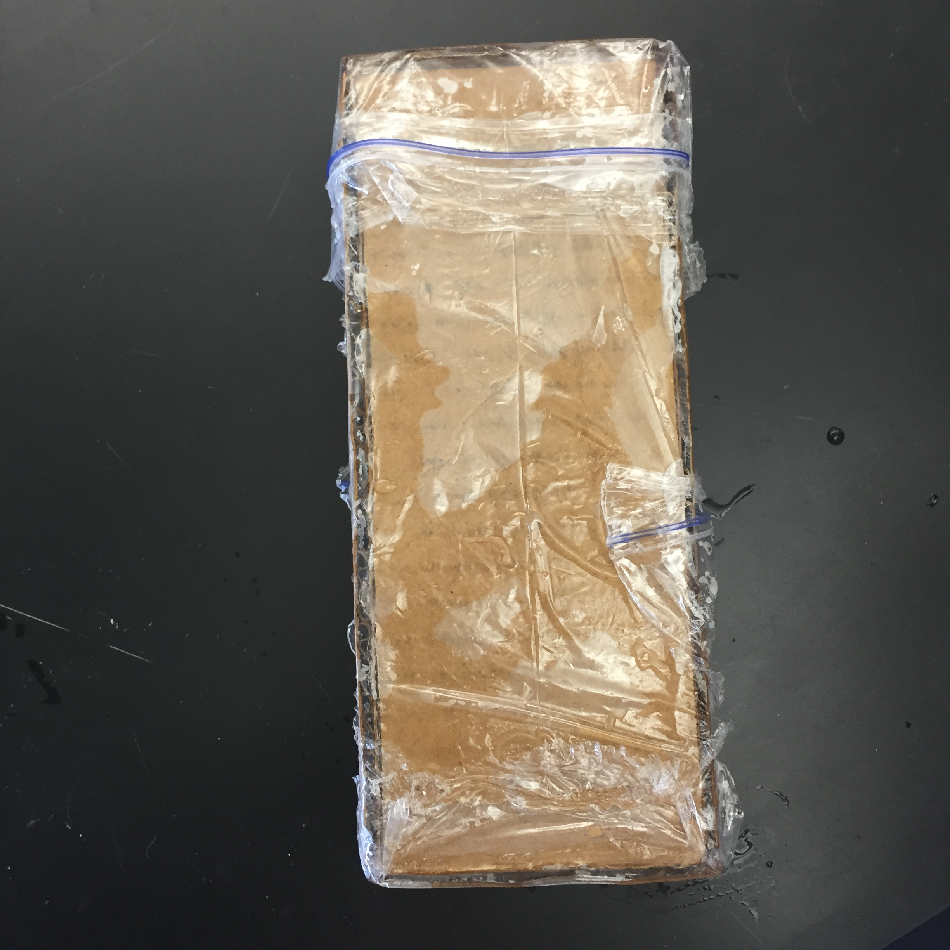
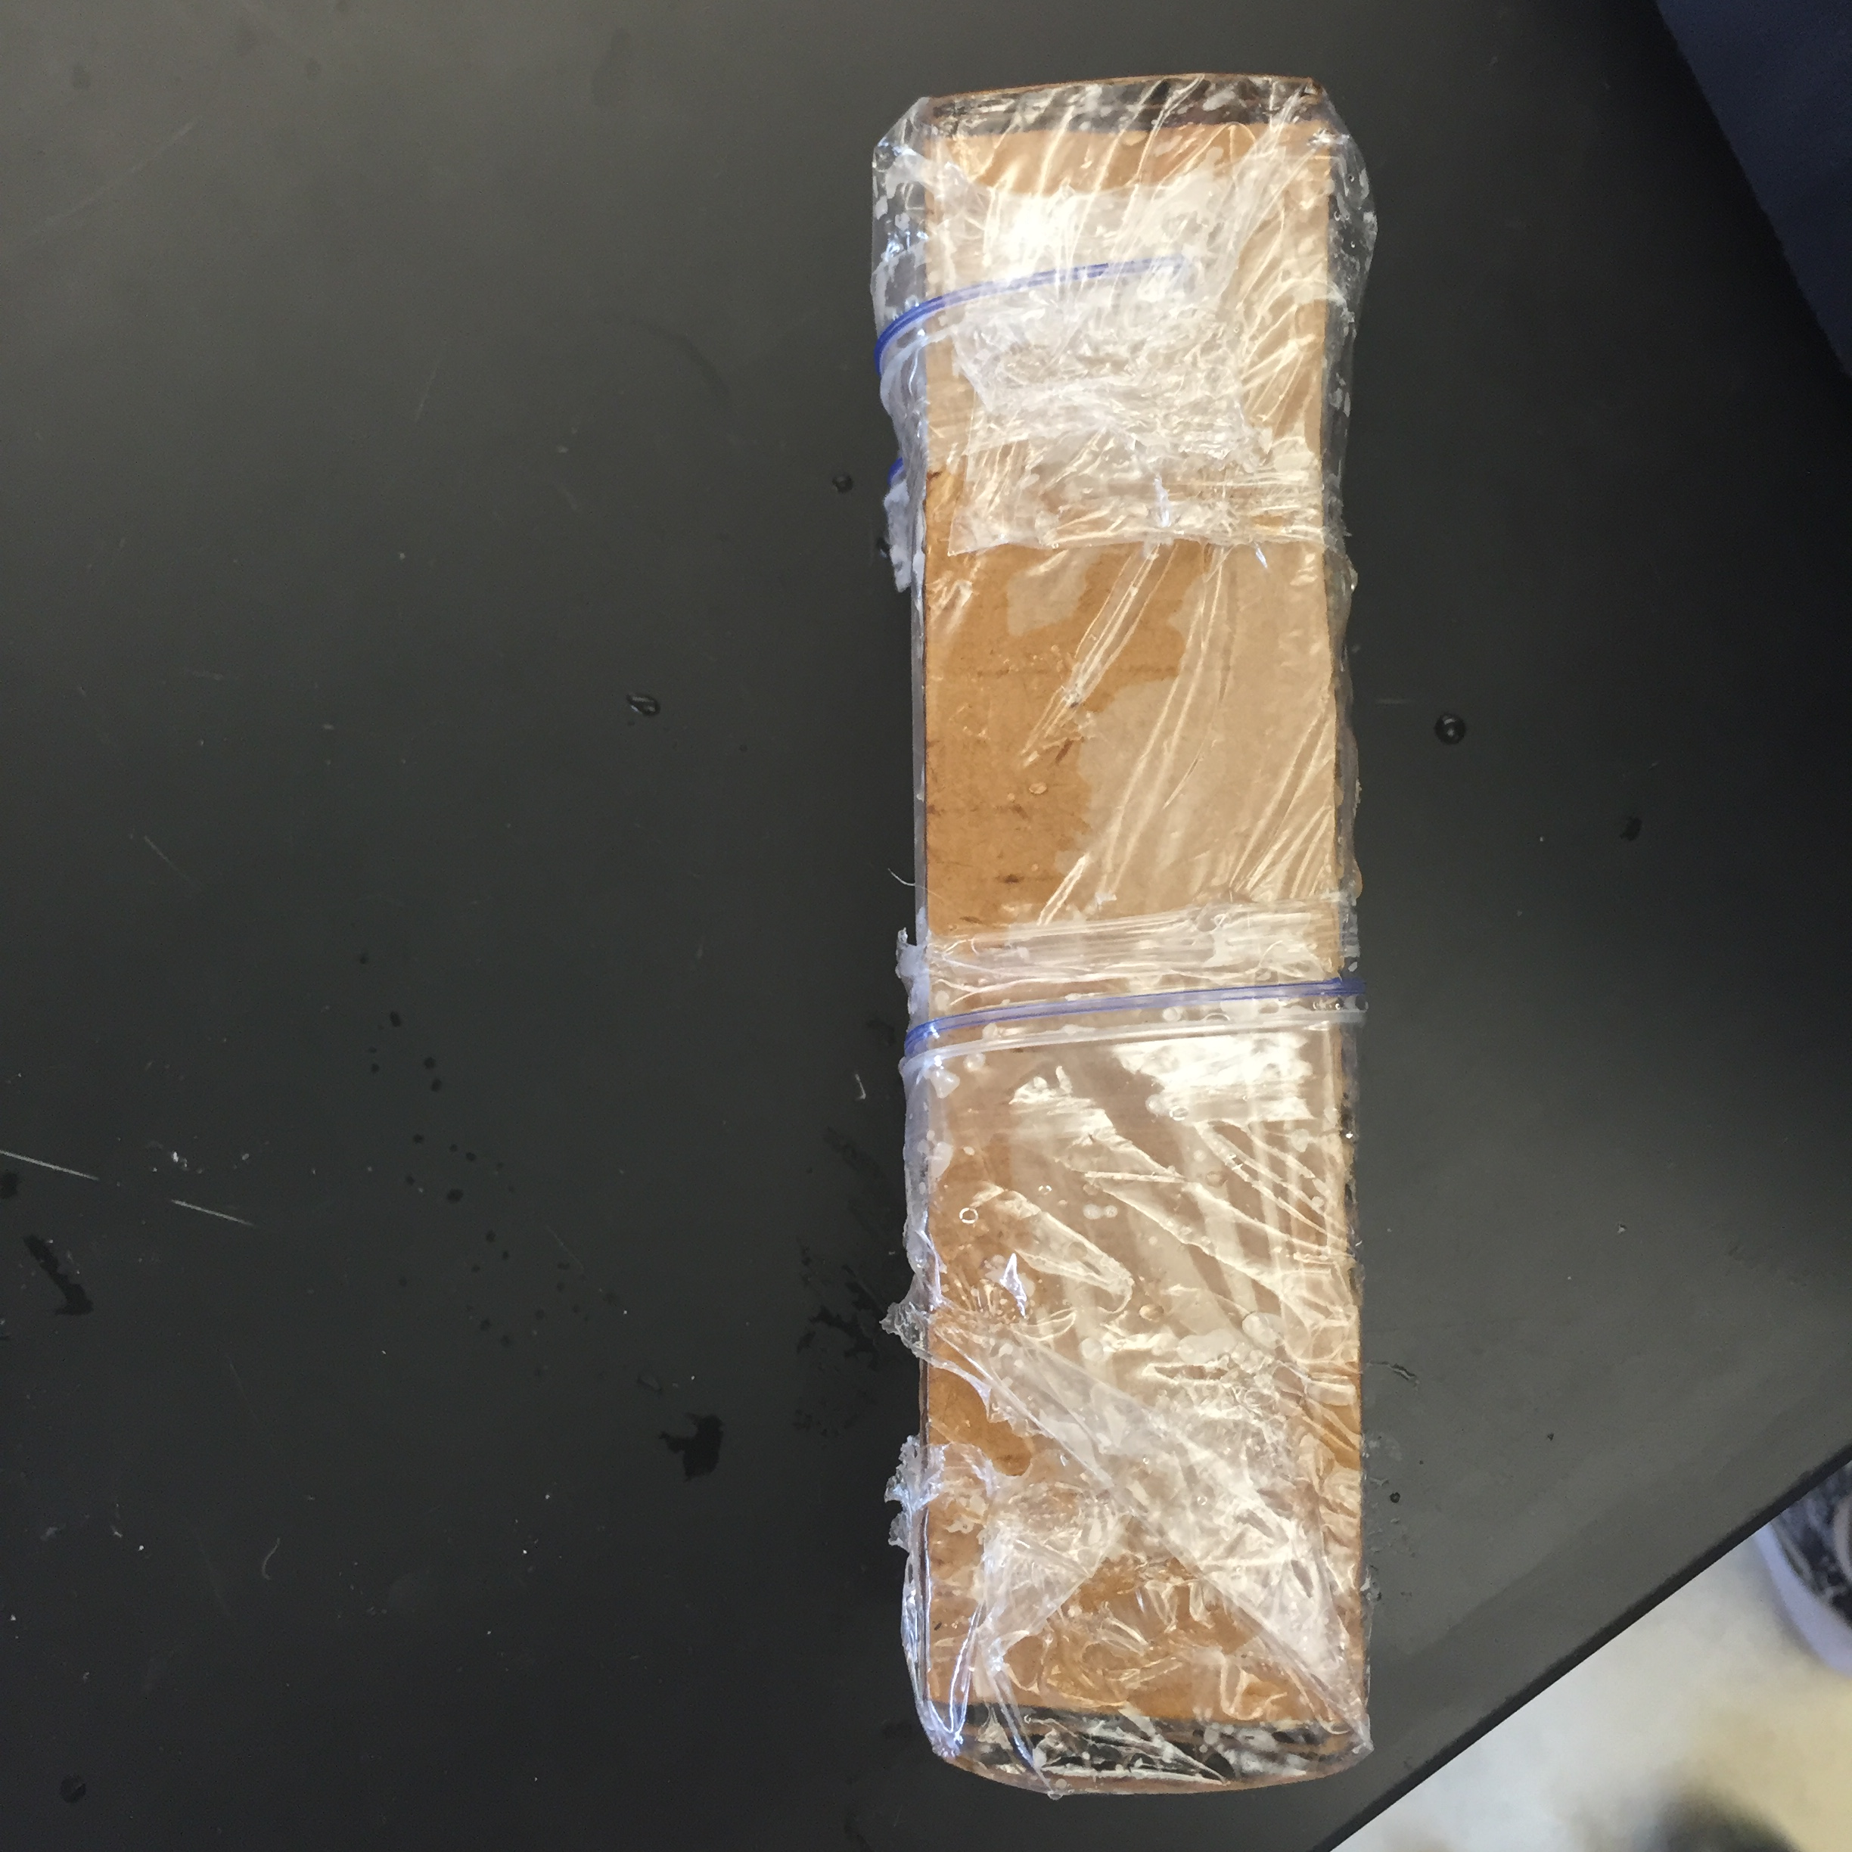
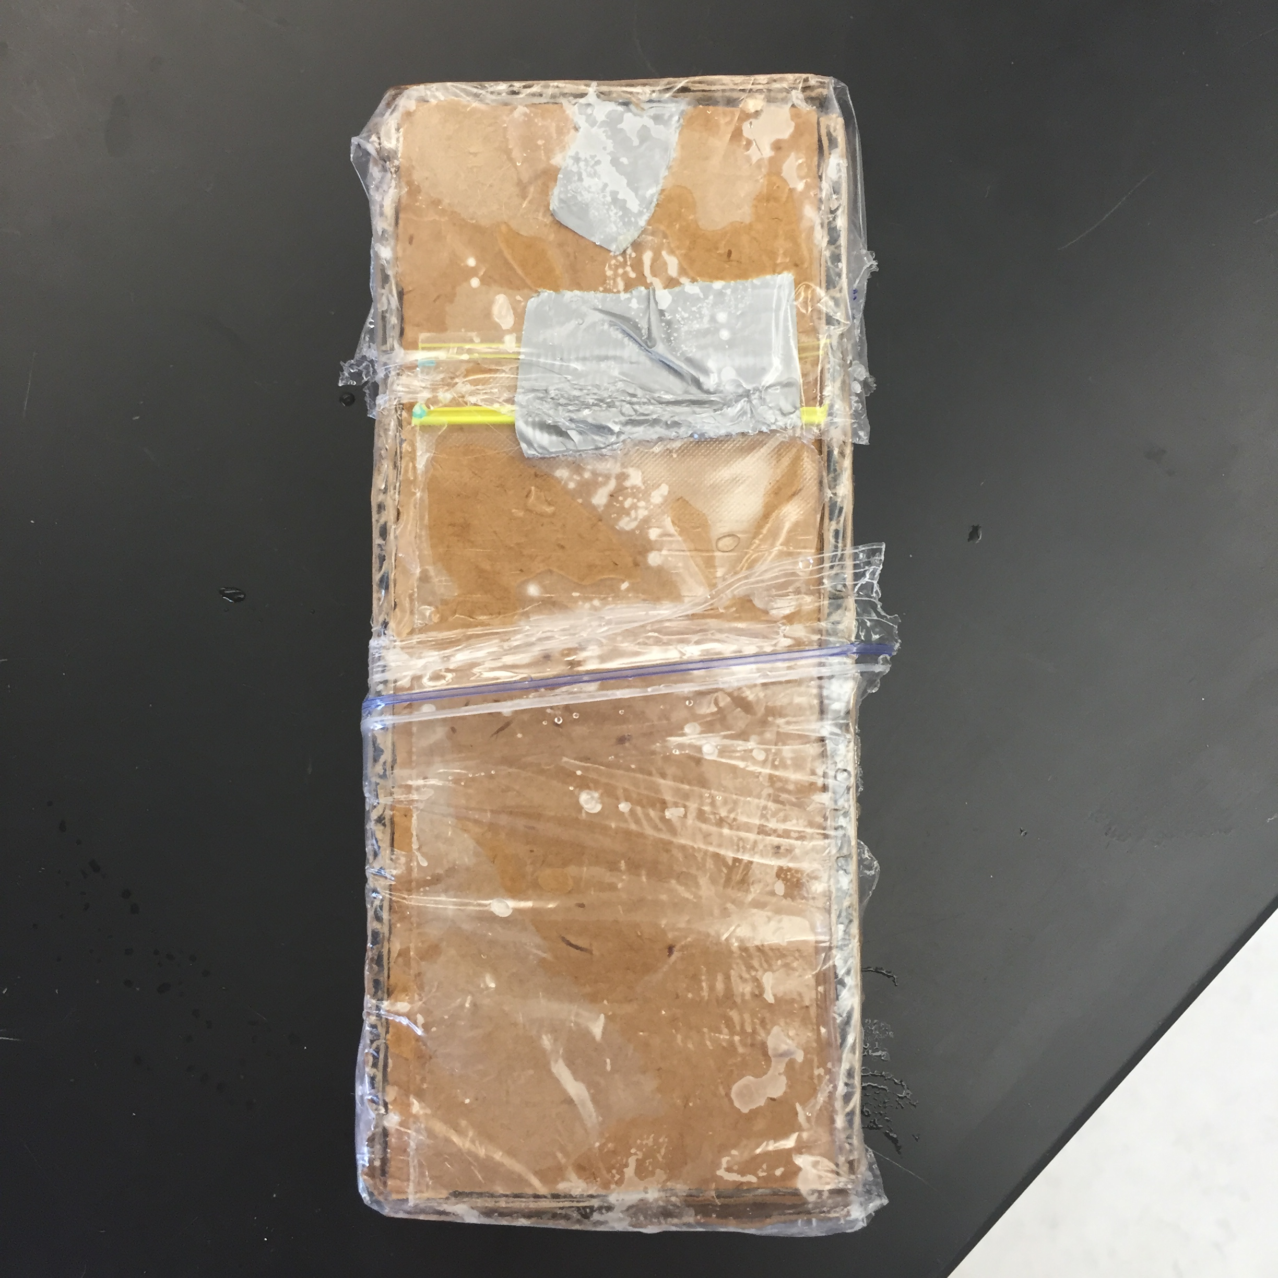
Initial package design
Plastic bag holding lotion, that bag surrounded by rectangular carboard box wrapped in plastic bags.
images:
Top view side view bottom view

Slide 8
Visual representation of product testing results
DAMAGE TESTS FOR PACKAGE NUMBER 1
ON SCALE FROM 0 (MOST DAMAGED) TO 3 (LEAST DAMAGED)
Package design | Drop test | Shake test | Weight test | Throw test | Water test | Heat test | Marketing test | Environmental test
#1 | 3 | 3 | 3 | 3 | 2 | 3 | 1 | Some recycle some non recycle

Slide 9
Spf and ld50 constraints
Max Spf values
Benzophenone restraint: must be less than 6% of total
om-cinnamate: must be less than 7.5% of total
Max ld50
We want an e-coli survival rate of 50-100%

Slide 10
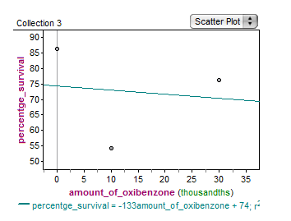
Oxy-benzone Ld50 test
We found that all amounts of oxy-benzone tested had an e-coli survival rate of 50-100%. This means that we can continue our tests at higher levels of oxy-benzone.

Slide 11
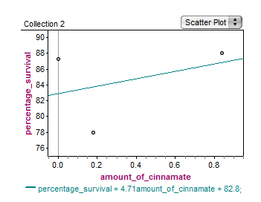
Cinnamate ld50 tests
We concluded that all amounts of Cinnamate tested had an e-coli survival rate of 50-100%. This means that we can continue our testing at higher levels of cinnamate.

Slide 12
Recommendations for formula mix
Benzophenone = less than and including 5.55 grams
Om-cinnamate= less than and including 7.05 grams
Total= 12.745% (less than constraint of 13.5% of total)

Slide 13
Benzophenone
Hazard class: acute toxicity, dermal (category 5), carcinogenicity (category 2)
May be harmful in contact with skin or eyes
Suspected of causing cancer
Hazardous in case of ingestion, of inhalation

Slide 14
Ethylhexylmethoxycinnamate (Om-Cinnamate)
General: May cause respiratory tract and skin irritation
Inhalation May cause respiratory tract irritation, coughing, wheezing, or shortness of breath
Non-irritating to the eyes
Skin Contact May cause mild irritation, itching, and redness after contact
Ingestion Not an intended route of exposure; treat as toxic if swallowed.

Slide 15
Final cost of package
Cost restriction: $3.00 with use of glue and $4.00 without use of glue
Our materials:
Total Cost= $3.00
$1.00 remaining cost unused
Materials | Unit Cost | Number of Units used | Cost of Materials for Our Package
Plastic Baggies | $0.25/each | 4 | $1.00
Tape | $1.00 | 2 | $2.00

Slide 16
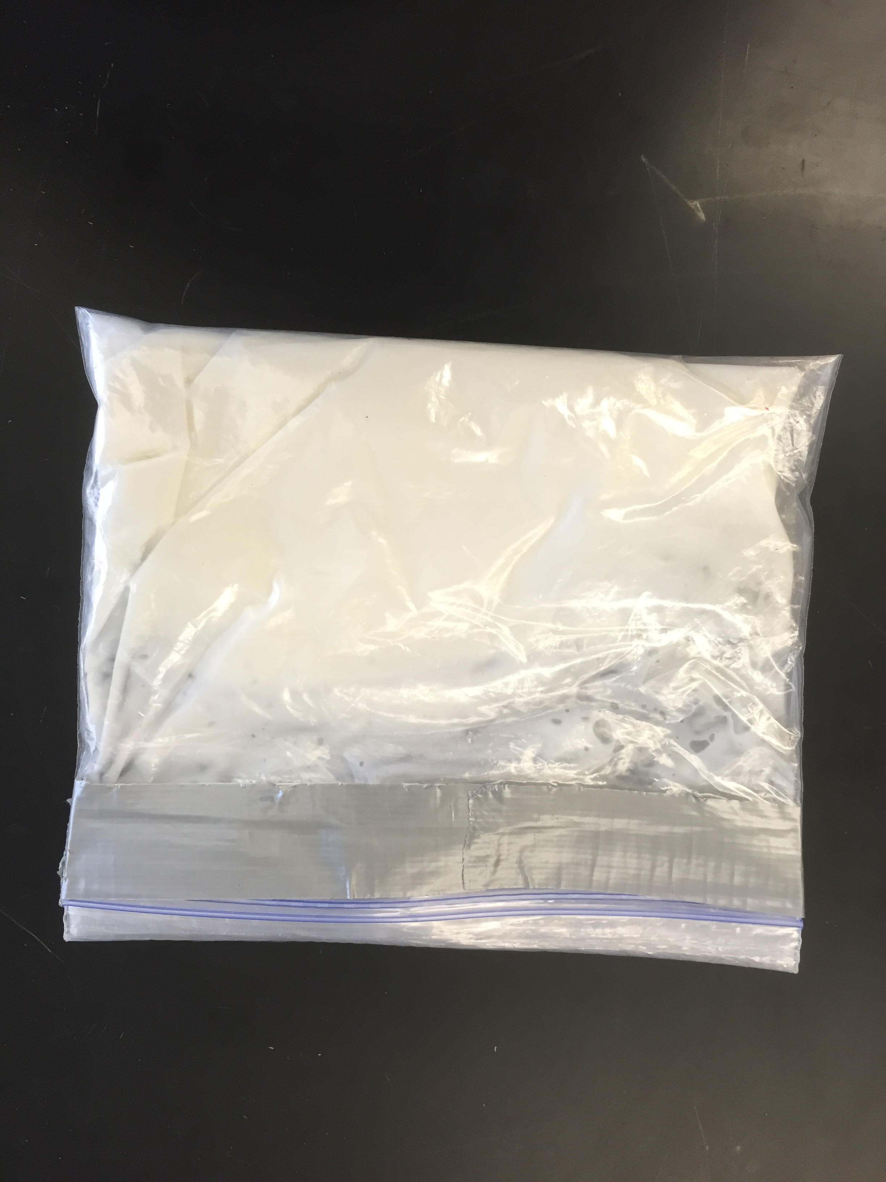
Final package design
Four plastic bags holding the sunscreen and tape covering the opening of the plastic bag
Image:

Slide 17
Visual representation of product testing results
DAMAGE TESTS FOR PACKAGE NUMBER 1
ON SCALE FROM 0 (MOST DAMAGED) TO 3 (LEAST DAMAGED)
Packaging Design | Drop Test | Shake Test | Weight Test | Heat Test | Water Test | Throw Test | Marketing Test | Environmental Test
#2 | 3 | 3 | 3 | 3 | 3 | 3 | 2 | Nothing is Recyclable

Slide 18
Daphnia test
Trials | Amount of Oxy (max) | Survival percentage | Amount of Oxy (mid) | Survival percentage | Amount of Oxy (control) | Survival percentage
1 | 3.13 grams | 0% | 1.5 grams | 0% | 0 grams | 100%
2 | 1.5 grams | 0% | .75 grams | 0% | 0 grams | 90%
Trials | Amount of Cinnamate (max) | Survival percentage | Amount of Cinnamate (mid) | Survival percentage | Amount of Cinnamate (control) | Survival percentage
1 | 4 grams | 0% | 2 grams | 0% | 0 grams | 100%
2 | 1.3 grams | 0% | .66 grams | 0% | 0 grams | 100%

Slide 19
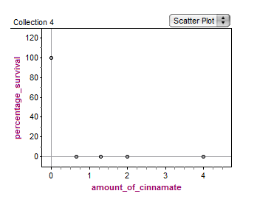
Daphnia Cinnamate test results

Slide 20
Daphnia Oxy test Results

Slide 21
Conclusion
As a result of the zero survival percentage of daphnia for all trials. We had to come up with significantly low numbers than what we previously tested with. We then came up with new chemical amounts:
Cinnamate (max): 0.02 grams
Cinnamate (min): 0.01 grams
Cinnamate (control): 0 grams
Oxy (max): 0.12 grams
Oxy (min): 0.06 grams
Oxy (control): 0 grams

Slide 22
Works cited
http://www.makingcosmetics.com/msds/msds-octyl-methoxycinnamate.pdf
http://www.sciencelab.com/msds.php?msdsId=9927097

