Slide 1
Harbor Pollution: Biofilms
Emma, Kendall, Quinn, Ruby

Slide 2
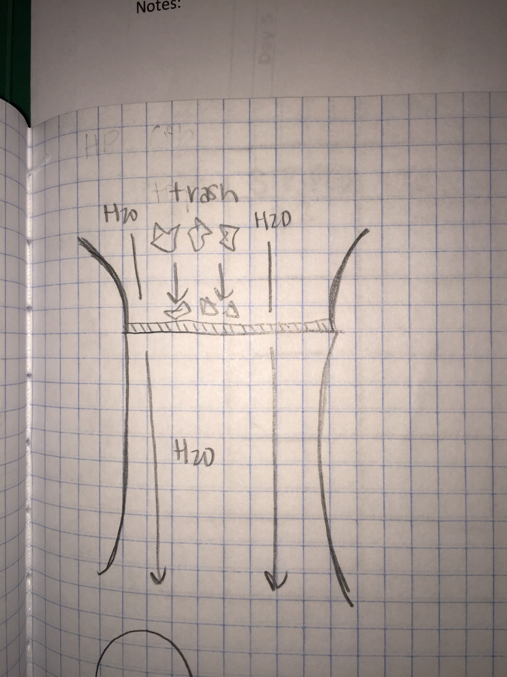
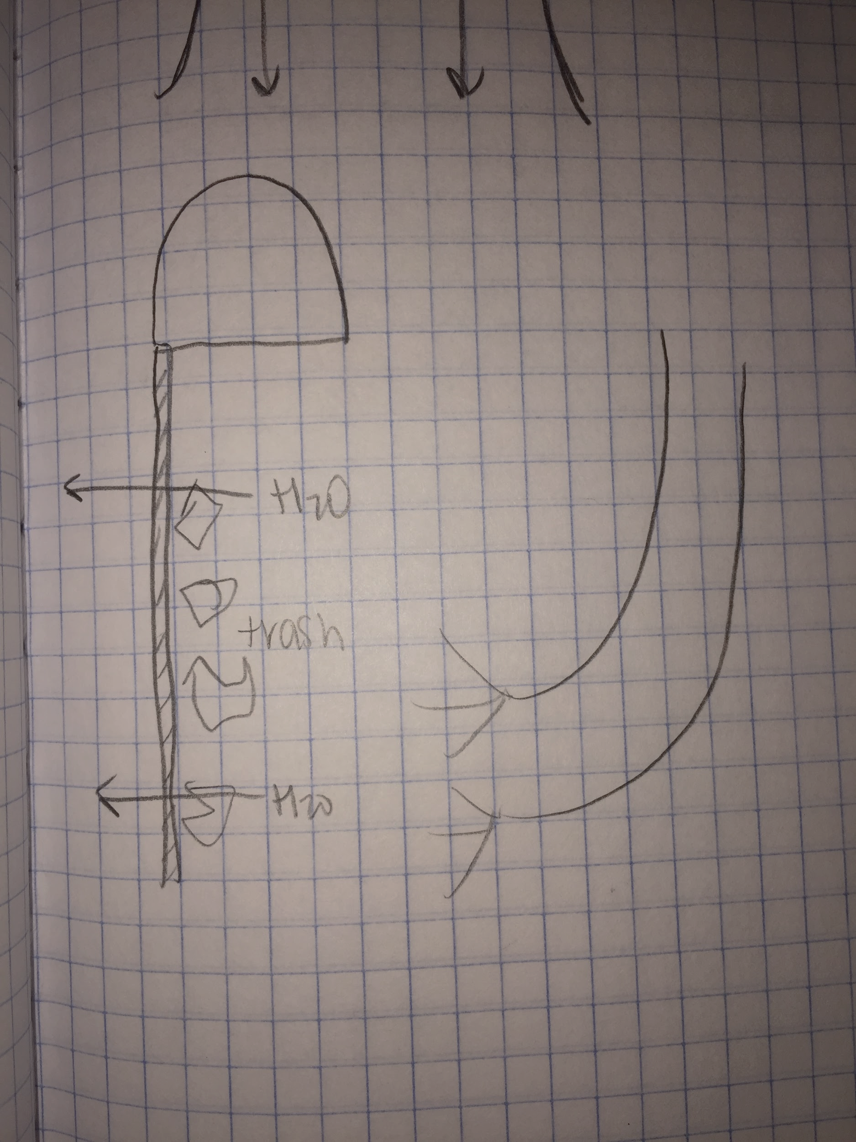
Initial ideas
Our initial plan to reduce the amount of pollution in the harbor, was to build a contraption that trapped the trash with a screen from the top and from the side
Notes:
Quinn

Slide 3
Modification of design
After discovering other contraptions similar to ours were too expensive, and biofilms started to form on these contraptions, we started to research biofilms as they prevented these contraptions from working to their full potential.
We found that anti-fouling paint blocks off the growth of biofilms, but also hurts organisms that help our harbor. Our research made us want to find a balance between decreasing biofilms and keeping the healthy organisms alive in the harbor.
Notes:
Kendall

Slide 4
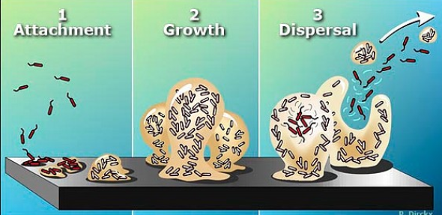
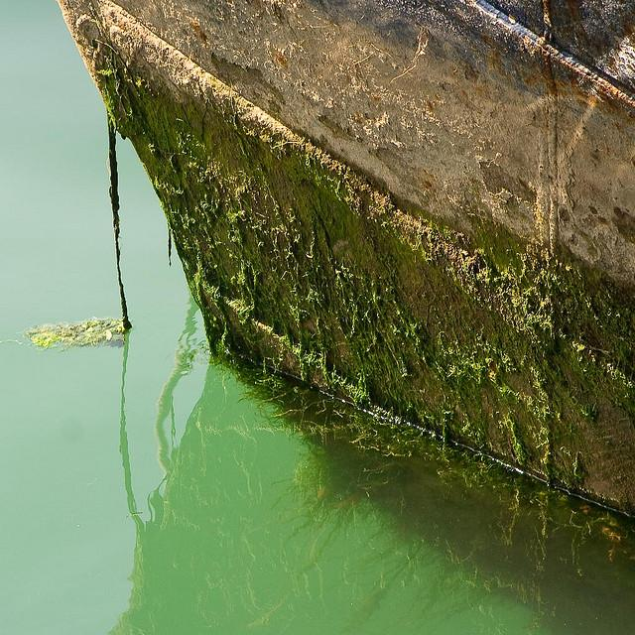
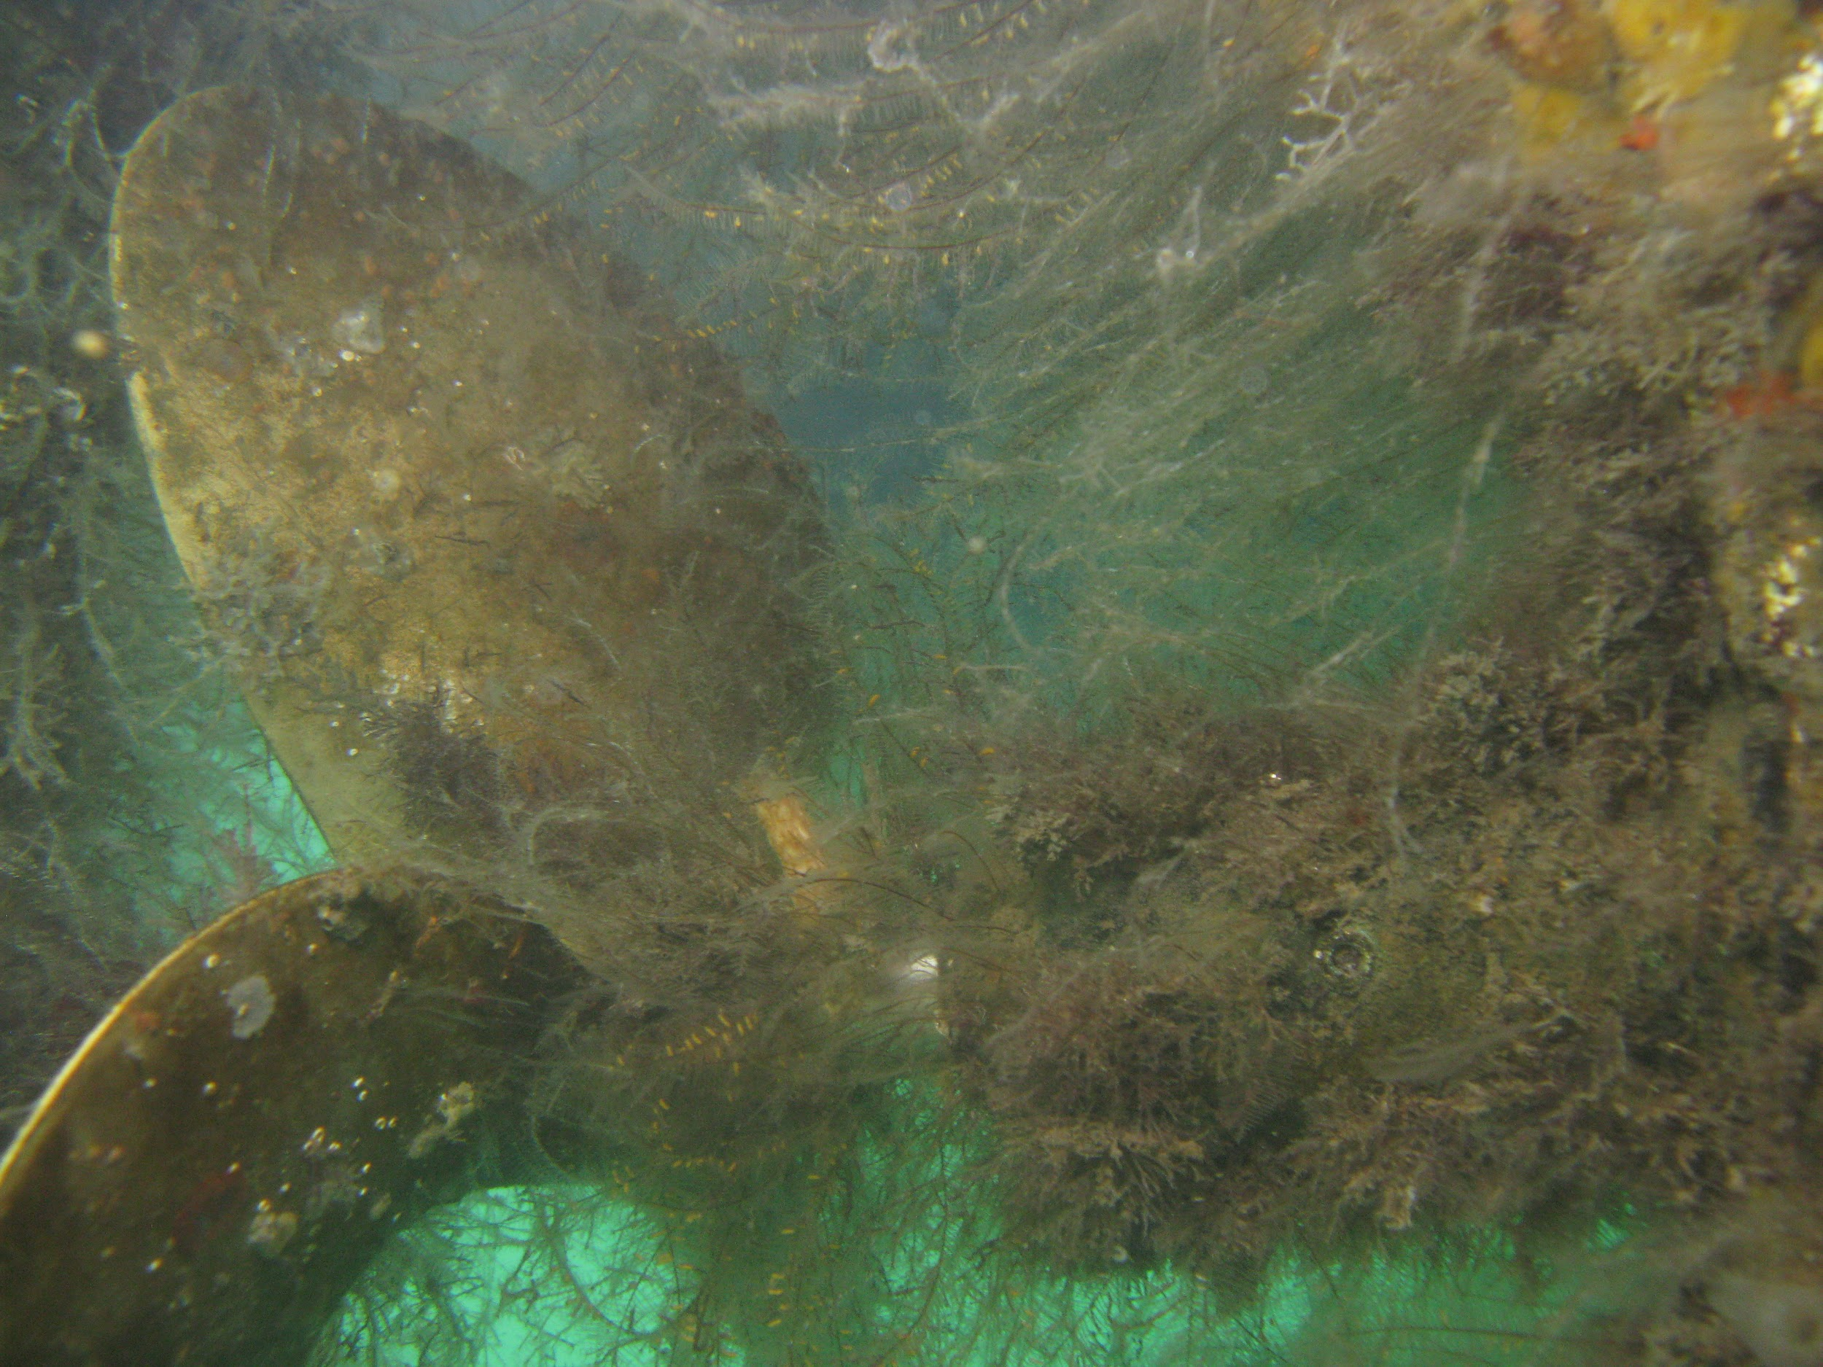
What are biofilms?
Biofilms form when bacteria collect on surfaces in damp or wet environments
Examples include...
- slime on rocks in a stream
- “Gunk” that lines and clogs your drain
3 steps that form biofilms
- Bacteria attach
- They grow forming a layer of biofilm
- Disperse spreading and creating more biofilms
Notes:
Emma

Slide 5
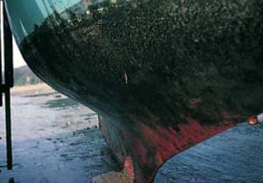
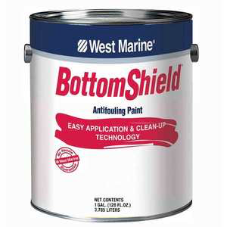
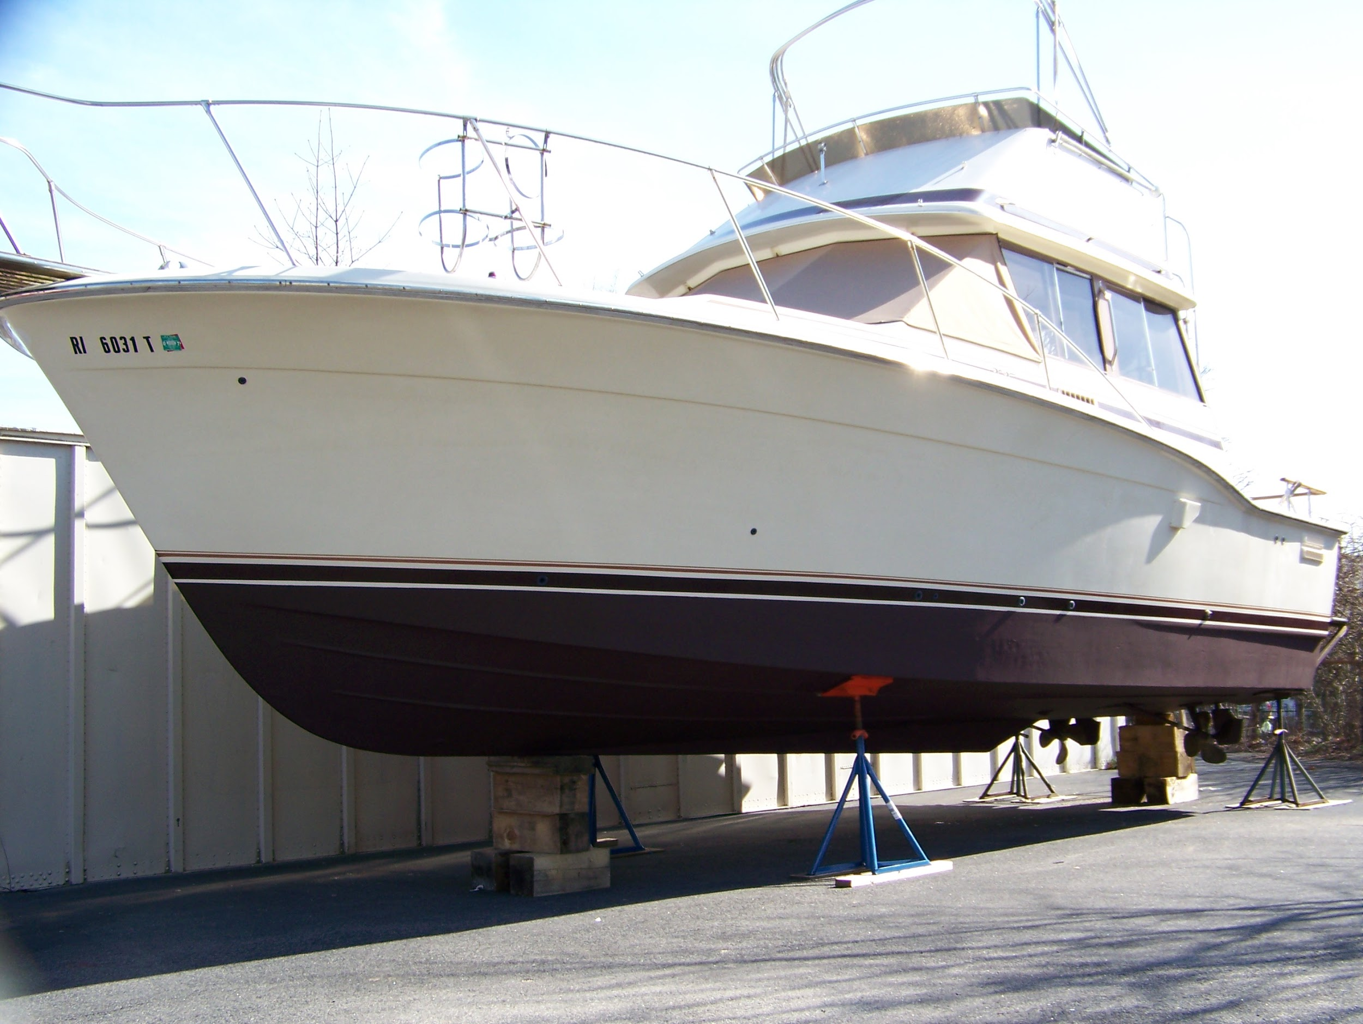
Anti fouling paint
A paint that goes on the bottoms of boats, and stops organisms such as barnacles and biofilms from producing, and eventually ruining the bottom of the boat.
Although antifouling can be a good thing for the protection of the boats, it kills off organisms in the harbor that do not need to be killed off
Chemicals like: cuprous oxide, thiocyanate, copper thiocyanate, Zinc cause the death of healthy organisms in our harbor
Notes:
Ruby

Slide 6
Copper
The copper in the anti-fouling paint causes damage to marine species particularly. The severity of the damage depends on the concentration of copper used, but the copper has ultimately caused:
deformities in shellfish and mollusc communities
reduced growth of algae
toxic effects in young fish
Reduced respiration rates in marine mammals
Notes:
Quinn

Slide 7
Project Constraint
Reduce the concentration of copper in the solution while also having the least amount of biofilms grow on the plastic flaps.
Notes:
Kendall

Slide 8
Cost analysis
Item in Final Product | Price | Space covers
Antifouling Paint Bottom Shield | $0.0414 | 2.155 square cm (the amount on 25% stripped dilution)
Tap water in Baltimore | $0.00963 | 6.465 square cm (the amount on the 25% stripped dilution)
According to our research 25% striped dilution is our choice to use as environmentally friendly antifouling paint.
Notes:
Emma

Slide 9
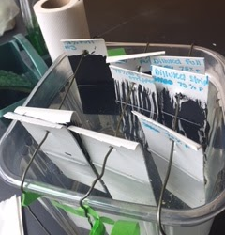
Description for testing set up
Cut the plastic gutter guard with a 5cm width
Paint according to dilution (50%, 75%)
- One Negative Control
- One Stripped
- One Full
Place in Harbor Water for 48 hours
Take out and observe bottom 2cmx2cm square under microscope
Record amount of biofilms attached
Notes:
Ruby

Slide 10
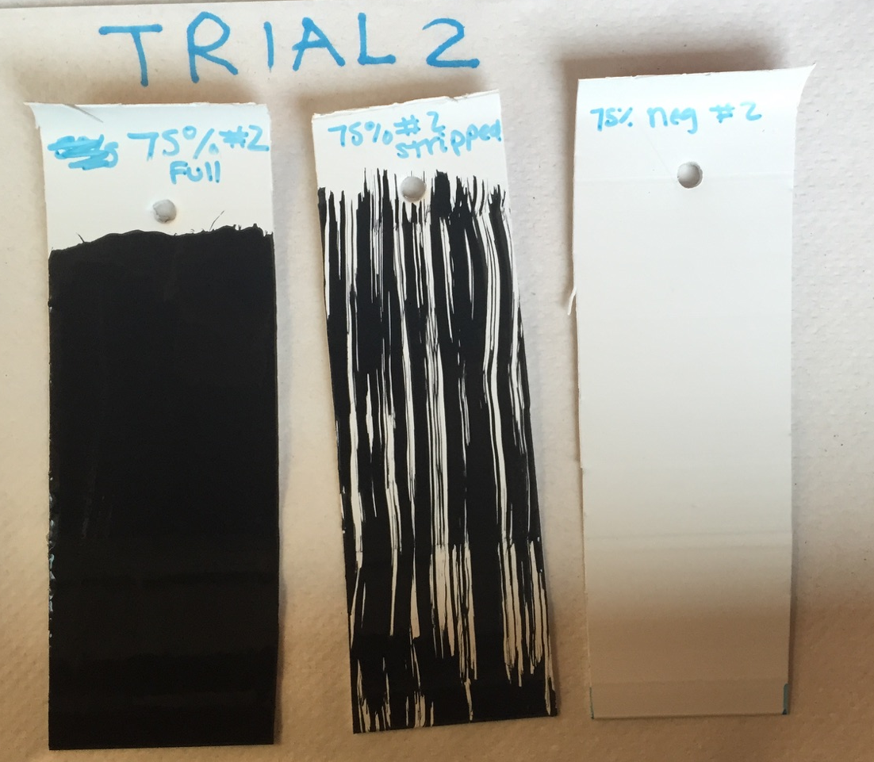
Testing continued...
When observing the amount of biofilms we are actually counting the amount algae we see on the 2x2cm square under the microscope
Used a magnification of 30X on a dissecting microscope to count the algae
Notes:
Quinn

Slide 11
Concentration of paint | Trial | No Paint | Striped Paint | Full Paint
100% - | 1* | 48 | 32 | 30
 | 2 | 33 | 8 | 8
 | 3 | 22 | 9 | 6
75% | 1 | 35 | 29 | 14
 | 2 | 18 | 32 | 10
 | 3 | 31 | 5 | 7
50% | 1 | 38 | 17 | 12
 | 2 | 29 | 12 | 8
 | 3 | 30 | 7 | 7
25% | 1 | 25 | 12 | 8
 | 2 | 22 | 10 | 3
 | 3 | 16 | 6 | 11
Note: our first trial was a baseline test, and we left the plastic strips with the paint on in the harbor water for longer and counted a bigger amount of the strip.
Notes:
Kendall

Slide 12
Average
 | No paint | Striped | Full paint
100% paint | 34.33 | 24.5 | 14.66
75% paint | 28 | 22 | 10.33
50% paint | 32.33 | 12 | 9
25% paint | 21 | 9.33 | 7.33
The dilutions seemed to be a success because we observed few biofilms while only using a fraction of the concentration of paint.
Notes:
Emma

Slide 13
Conclusion
We have finished collecting our data
From our data we can conclude that the 25% stripped dilution is the most environmentally friendly while also yielding successful results.
As always results are more accurate with more trials so we urge you to continue looking into the dilution of anti-fouling in regards to its environmental safety and effectiveness.
Notes:
Ruby

Slide 14
Sources
http://www.jamestowndistributors.com/userportal/document.do?docId=326
http://www.westmarine.com/bottom-paint
http://www.westmarine.com/WestAdvisor/Top-Ten-Antifouling-Paint-Buying-Questions
http://www.yachtpaint.com/LiteratureCentre/antifouling_101_usa_eng.pdf
http://www.bottompaintstore.com/manufacturers-eco-friendly-boat-bottom-paint-c-14054_13530.html/smart-solution-metal-free-bottom-paint-p-9937.html
http://www.baltimorecountymd.gov/Agencies/publicworks/metro/metro_swrsrvchg.html
https://www.biofilm.montana.edu/biofilm-basics-section-1.html
http://physicsbuzz.physicscentral.com/2013/01/researchers-develop-new-material-to.html
http://www.serc.si.edu/labs/marine_invasions/feature_story/October_2012.aspx
http://www.scottsboatservice.com/bottompaint.html
http://www.ukmarinesac.org.uk/activities/ports/ph4_3_1.htm

