Slide 1
Sierpinski Shapes
By Quinn Alban & Kendall Lambert

Slide 2
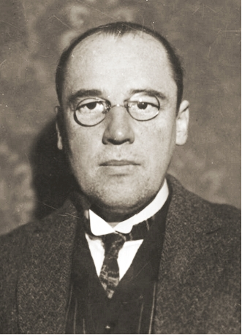
Who is Mr. Sierpinski?
Waclaw Sierpinski was born on March 14, 1882, and died on October 21, 1969. He lived in Poland for his whole life, and studied various branches of math. He was known for outstanding contributions to set theory, number theory, theory of functions and topology. He created the idea of Sierpinksi shapes such as the Sierpinksi triangle, carpet, sponge.

Slide 3
What does a Sierpinski Shape Consist of?
All Sierpinski shapes share the same properties. Sierpinski shapes involve an infinite number of holes being cut out of a set shape, yet the shape never fully disappears.
Analogy: Like taking half a step towards a wall each time- you will never reach the wall, The shape will never be entirely cut out.

Slide 4
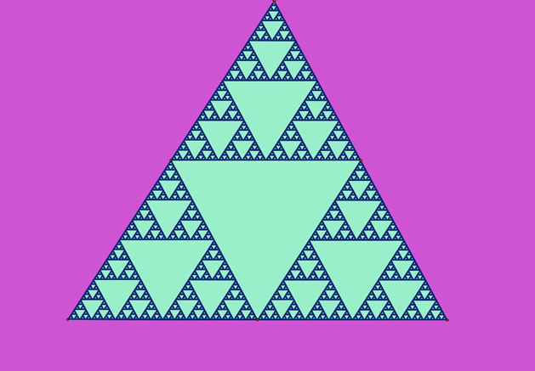
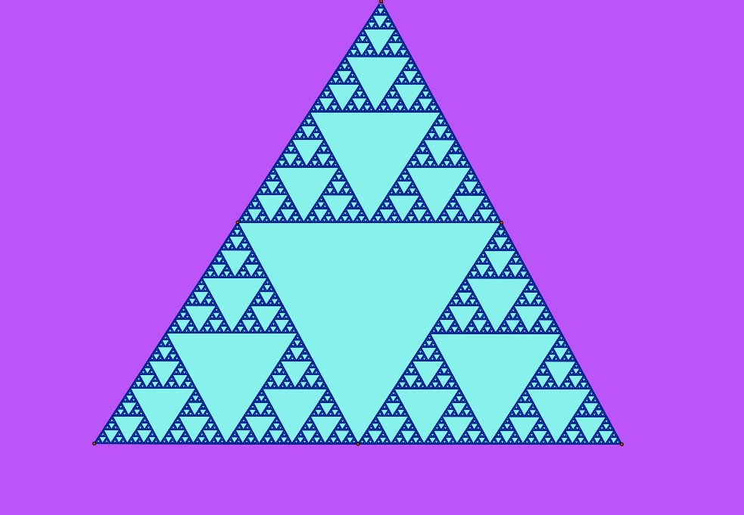
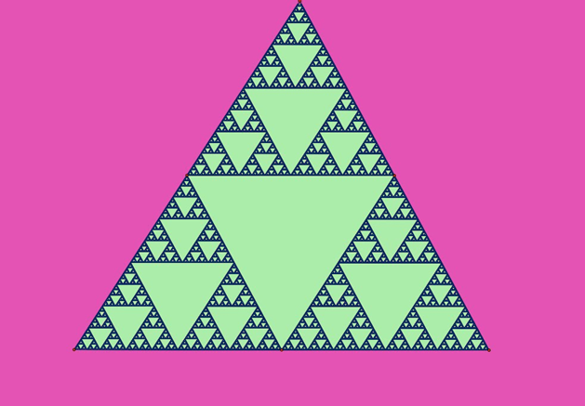
Sierpinksi Triangles- What are they?
Sierpinski Triangles are a fractal based on a triangle with four equal triangles inscribed in it. The central triangle is removed and each of the other three treated as the original was, and so on, creating an infinite regression in a finite space.

Slide 5
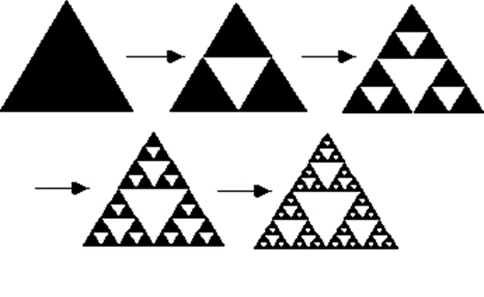
Sierpinski Triangles- Visual Explanation
When one of the four equal triangles are removed, it creates three separate triangles. Those new tree triangles also consist of four equal measure triangles. Removing one of those four, again, creates three separate triangles with four equal triangles within. This pattern goes on forever as sierpinski triangles have an infinite number of triangles.

Slide 6
Sierpinski Triangles- Visual aid

Slide 7
Sierpinski Sponge
The same concept as Sierpinski Triangles goes with Sierpinksi sponges- except in this instance, a hole is cut out of the cube and pushed all the way through. However, like the Sierpinski triangle, this goes on infinitely, meaning the entire shape will never disappear or be fully cut out.

Slide 8
Sierpinski Carpet
the Sierpinski carpet, is very similar to the triangle. this fractal is generated by cutting a hole in the middle of a flat square, and repeating this step indefinitely. it never reaches an end of when it will be completely cut out.

Slide 9
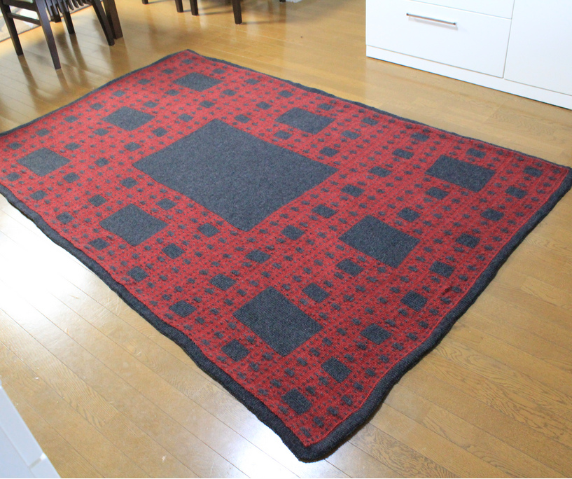
Sierpinski Carpet- Creative Uses
This pattern that is used everywhere, and most people don’t even think of it as math. This is an example of hoe people use this pattern artistically and creatively.

Slide 10
QUIZ TIME!!!!!
What analogy is similar to sierpinksi shapes?
Like taking half a step towards a wall each time
What is a sierpinski triangle?
triangle with four equal triangles inscribed in it. The central triangle is removed and each of the other three treated as the original was, and so on, creating an infinite regression in a finite space.
Sponge?
a hole is cut out of the cube and pushed all the way through, repeating infinitely.
Carpet?
cutting a hole in the middle of a flat square, and repeating this step indefinitely
BONUS: Where was he born and raised?
POLAND!!!!

Slide 11
Bibliography
http://1.bp.blogspot.com/_TP9AX9E0uBU/TBENEJTFirI/AAAAAAAAADU/A0gW1qftJaI/s1600/sierpinski+triangle.jpg
http://paulbourke.net/fractals/gasket/
http://farm7.staticflickr.com/6124/6006952127_272a396f84_b.jpg
https://www.youtube.com/watch?v=QsMvoui5WlQ
http://www.math.cornell.edu/~lipa/mec/lesson4.html

