Slide 1
Stage Gate #1
By: Quinn, Bella and Emma

Slide 2
Product Constraints
Max LD50 Value
Max SPF (using the legal limit of 6% Benzophenone and 7.5% Ethylhexylmethoxycinnimate)
Attempt to reach the Minimum Cost
Maximum Cost for Packaging ($3 with glue, $4 without glue)
Highest Packing Materials Testing Criteria

Slide 3
Cost analysis
Cetyl Alchol : (2 g) $0.05 …………..from Making Cosmetics
Benzophenone-3 : (max of 5.28 g) $0.0036 (for max)…………..Alibaba.com
Ethylhexylmethoxycinnimate : (max 6.6 g) $.0198 (for max) …………..Alibaba.com
Steric Acid : (4 g) $0.003 ………….Bulk Apothecary
Glycerin : (2 g) $0.10 ………….. Lotion Crafter
Trethanol Amine : (1 g) $0.02 ………….. Ebay.com
Water Distilled : (78 g) $0.02 …………..Walmart
Total: $0.25

Slide 4
MSDS Safety Precautions
Benzophenone and Ethylhexylmethoxycinnamate
If in contact with your skin
Wash with soap and water
Cover irritated skin with emollient
Get medical attention if irritation develops
When using , wear gloves and goggles.
For further information visit: http://www.sciencelab.com/msds.php?msdsId=9926361
http://www.sciencelab.com/msds.php?msdsId=9925850

Slide 5
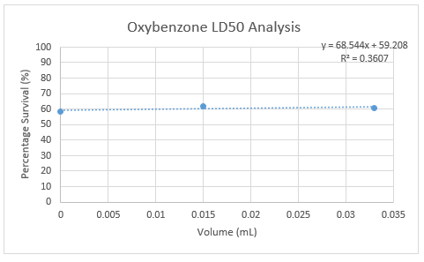
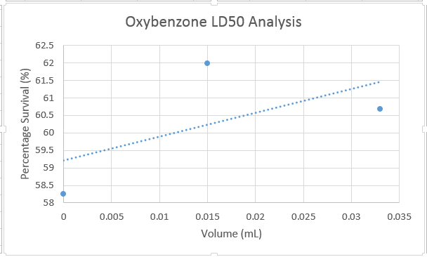
LD-50 Testing
Benzophenone (0xybenzone) Graph
Raw Data Available Upon Request
Zoomed in Graph

Slide 6
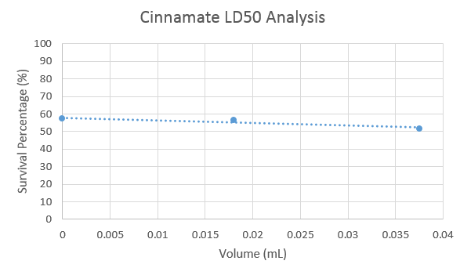
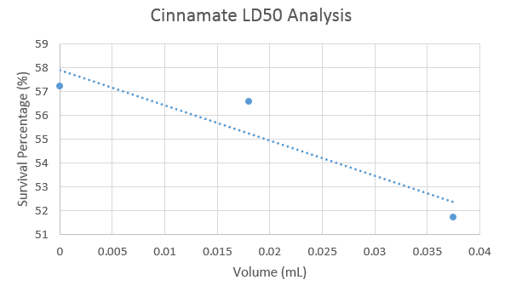
LD-50 Testing
OXYBENZONE
CINNAMATE
Ethylhexylmethoxycinnimate (cinnimate)
Zoomed in Graph

Slide 7
Packaging

Slide 8
Materials Test Findings
Material | Drop Test | Throw Test | Weight Test | Shake Test | Water Test | Heat Test
Recyclable Newsprint | 2.33 | 2.66 | 3 | 3 | 1 | 3
Cardboard Square | 3 | 2 | 3 | 3 | 2 | 3
Plastic Baggie | 3 | 3 | 3 | 2 | 3 | 3
Plastic Wrap | 2 | 1.33 | 2 | 2 | 2 | 3
Foil | 2.66 | 1 | 3 | 3 | 2 | 2
Wax Paper | 3 | 2 | 3 | 3 | 3 | 2
Duct Tape | 3 | 3 | 3 | 2 | 3 | 3
Masking Tape | 3 | 3 | 3 | 3 | 2 | 3
We believed the cardboard, plastic baggies and duct tape withheld under these tests best and were the most durable. Therefore we decided to implement them in our design.

Slide 9
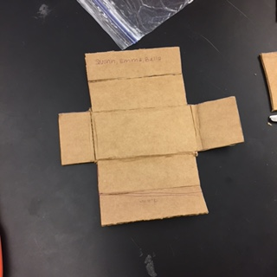
Design 1
 | Design # 1 2/29/16 |  | Notes
 | Horizontally | Vertically
Drop Test | 1 | 1 | H & V—Lotion bag came out but still useable
Shake Test | 2.75 | 2 | H- flap came out V-flap came out and fell to its side
Weight Test | 3 | 2 | H-with stood the weight well V- the flap came out
Thrown Test | 0.5 | 1 | H & V- lotion falling out
Water Test | 1.5 | 1.5 | The less dense parts (flap) held up worse than other parts but the lotion remind dry in the plastic bag
Heat Test | 2 | 2 | Tape broke on the sides
1 Cardboard, 3 Duct Tapes, 1 Plastic Bag
Cost of =$3.50

Slide 10
Next Steps…

Slide 11
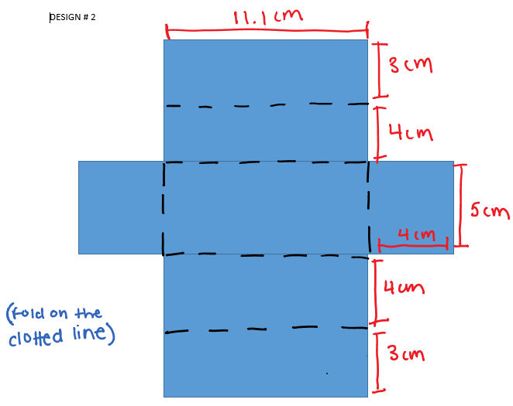
We’ve begun working on design 2.
Changes include
Hot glue on the sides
A tape seal for the lid

