Slide 1
Stage gate #2 presentation The sensafloat
Mary Pate, Hadley Saba, and Amber Bustard

Slide 2
Project constraints
We first identified some major ways water is wasted in our society
24% of water used in the household comes from flushing of the toilet
Currently, there are toilets that allow humans to differentiate their type of waste manually, using more water for solid waste than liquid waste, but human error and carelessness still results in wasting of water
These dual-flush toilets use at most 1.1 gallons (4L) for a full flush and about 0.55 gallons (2L) for a half flush
Notes:
Add facts
Add links from facts to last side

Slide 3
Project Goals
Our plan is to create a plumbing system within the toilet that will be able to:
Automatically determine the type of waste through mass increase, and the speed of the mass increase
Using this data, we will create algorithm that will determine the minimum amount of water needed for each specific flush

Slide 4
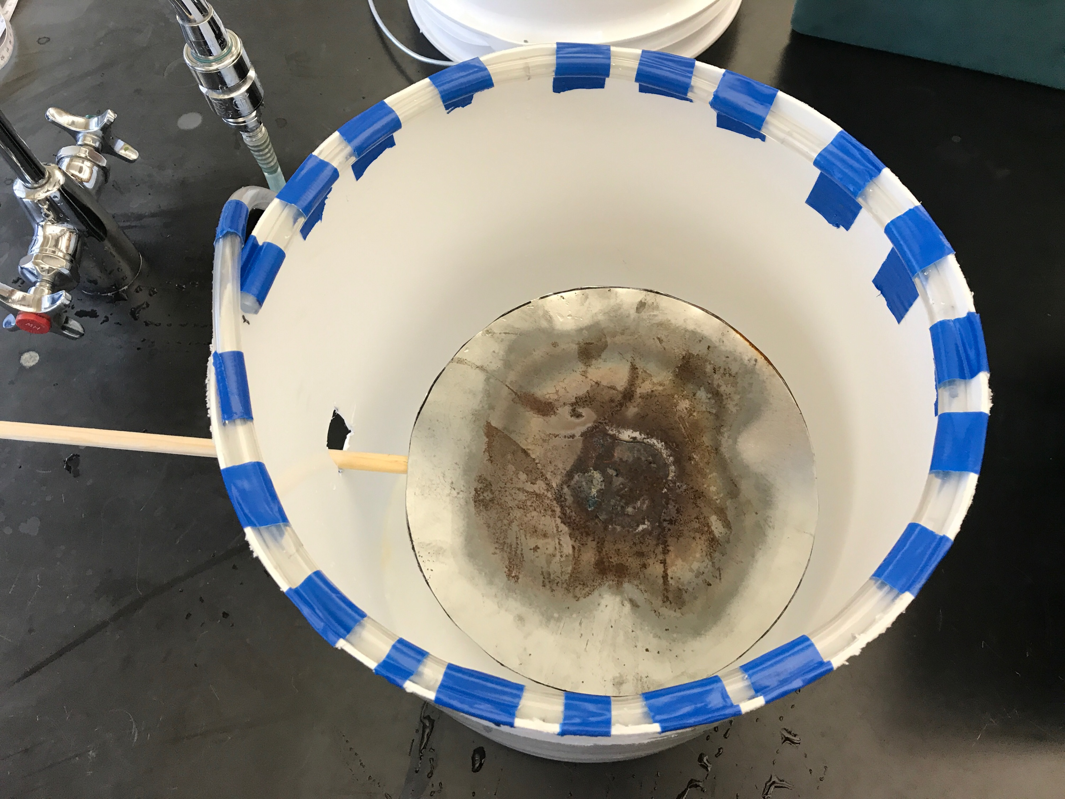
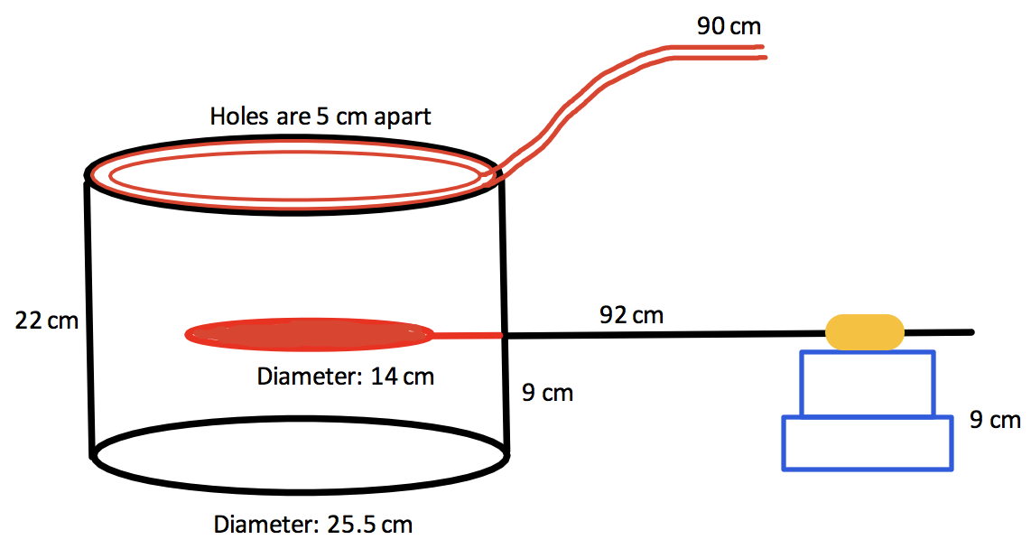
Our First Design: The Toilet
Notes:
Mary

Slide 5
Why did the Toilet Fail?
Mechanically:
No ideal way to flush the toilet
Unsanitary aspects of the design
The sensor was outside the toilet, making its size and shape inconvenient
Marketing:
Not desirable for users
Cost would be equal to that or normal toilets, but a normal toilet is much more luxurious
Notes:
Mary

Slide 6
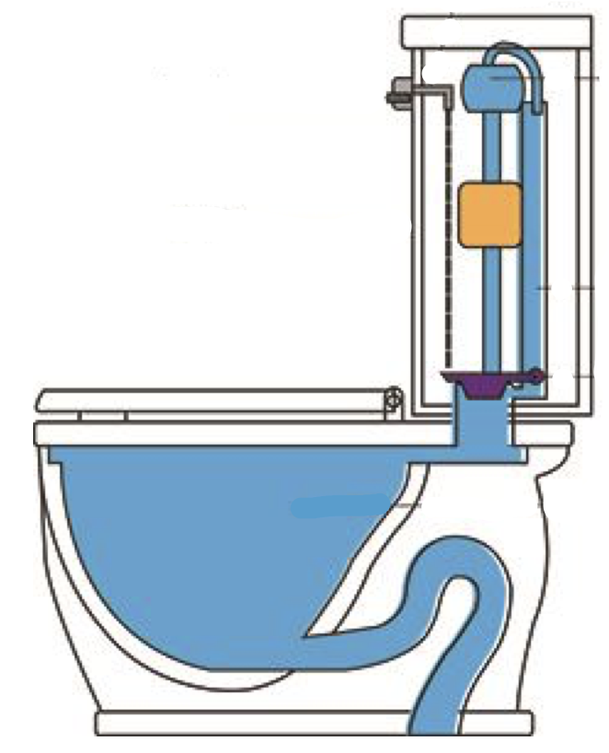
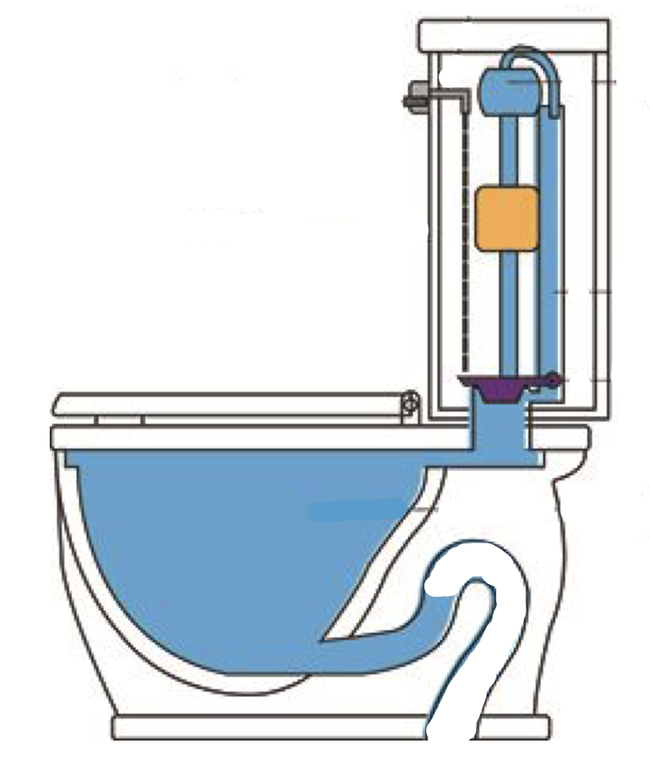
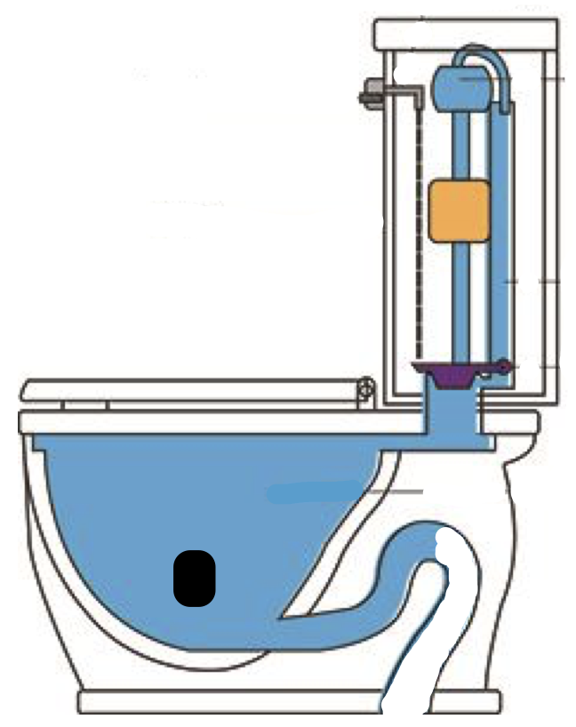
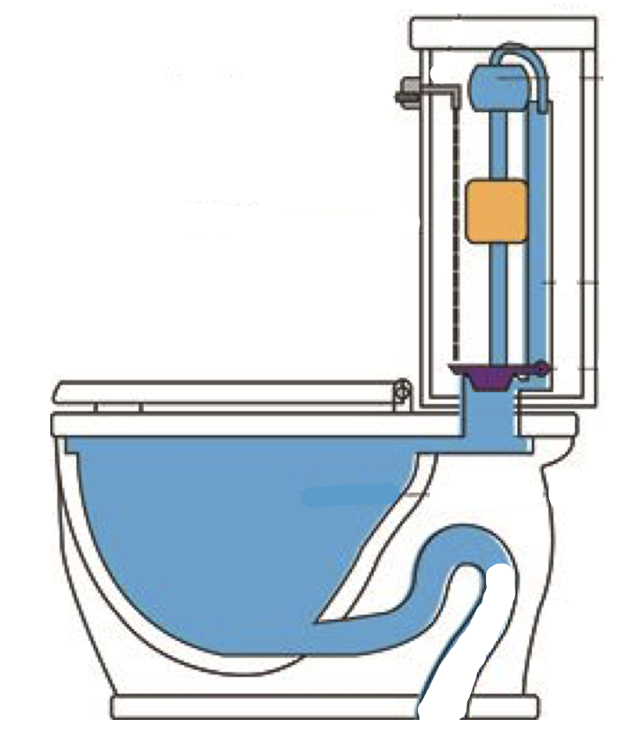
Standard toilet:
Water in the toilet bowl is displaced by the waste dispensed into the toilet
In the US, the majority of toilets (standard model) uses 5.00 gallons per flush, regardless of the type or amount of waste
Notes:
Mary

Slide 7
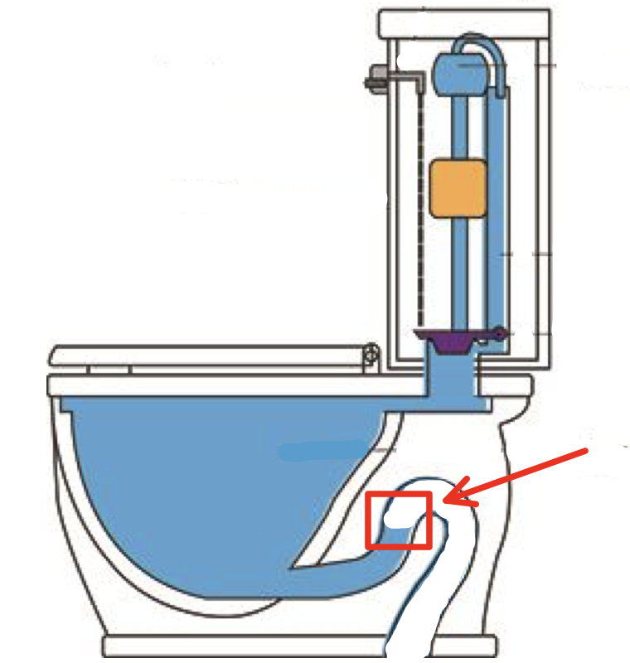
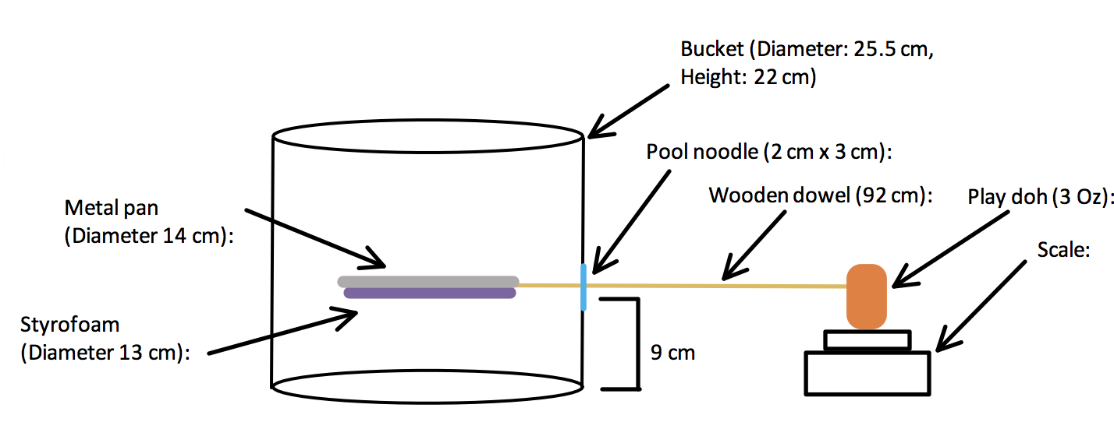
New design:
Notes:
mary

Slide 8
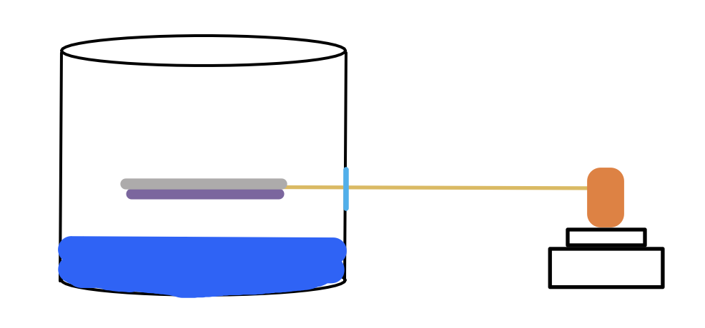
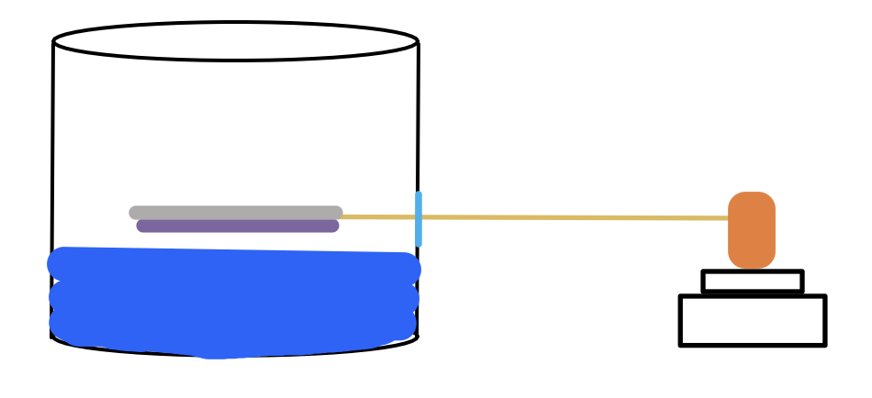
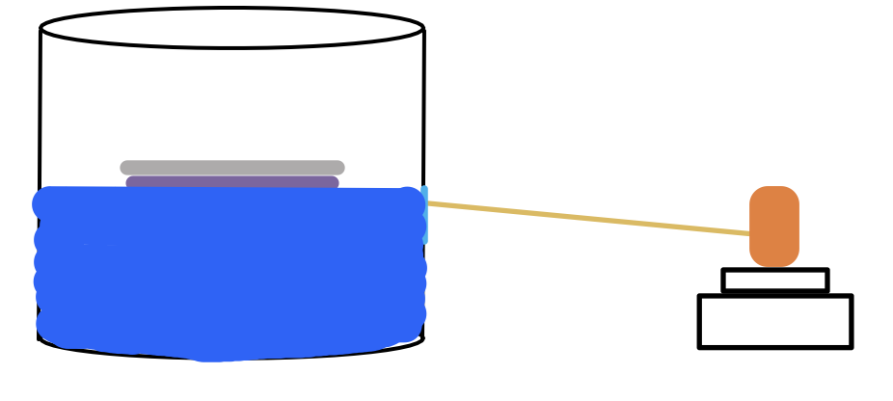
How it works:
Notes:
mary

Slide 9
Testing Step By Step
Goal: to simulate both solid and liquid wastes in order to determine the change in mass and the rate of change of the mass in order to construct a sensor that would determine both; the type of waste, and the amount of water necessary per flush
Fill the bucket with 6 liters of water, and zero the scale to 0 grams.
Gradually add 300 ml of water to the bucket to simulate liquid waste. Start timing the time of the mass to finalize once the water hits the water already in the bucket.
Record the mass change and the amount of time it takes for the scale to finalize the change in mass value.
Notes:
amber

Slide 10
TESTING STEP BY STEP CONTINUED
4. Repeat step 1.
5. To simulate solid waste, add a 300 gram weight to the water, and start the timer once the weight hits the surface of the water already in the bucket.
6. Record the mass change and the amount of time it takes for the scale to finalize the change in mass value.
7. Repeat steps 1-6 for A TOTAL OF 3 TRIALS.
Notes:
amber

Slide 11
Testing Results
Liquid Waste Data Table
Trials | Amount Added (mL) | Time for final mass change (s) | Change in mass (g)
1 | 300 | 4.22 | -13.7
2 | 300 | 3.51 | -10.5
3 | 300 | 4.15 | -12.7
Observations:
When the water was poured, the pan submerged under water, causing the pan to be weighed down versus float up.
The device is supposed to float, and mass is supposed to be gained, not lost so we did not test the solid waste with this device. (Added Styrofoam instead)
Modification: Add Styrofoam under the metal pan to guarantee floatation
Notes:
amber

Slide 12
Design 2 failure
Notes:
amber

Slide 13
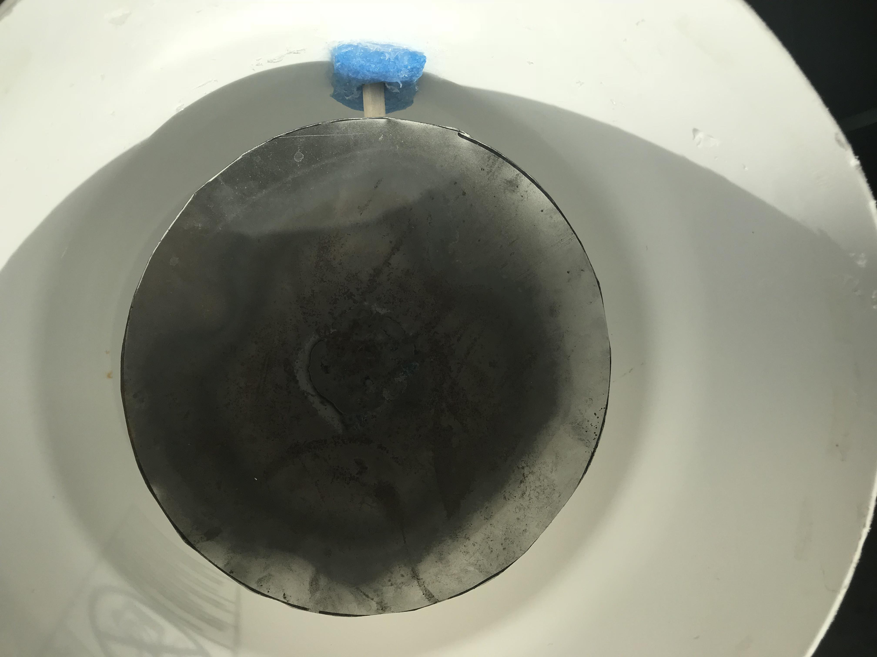
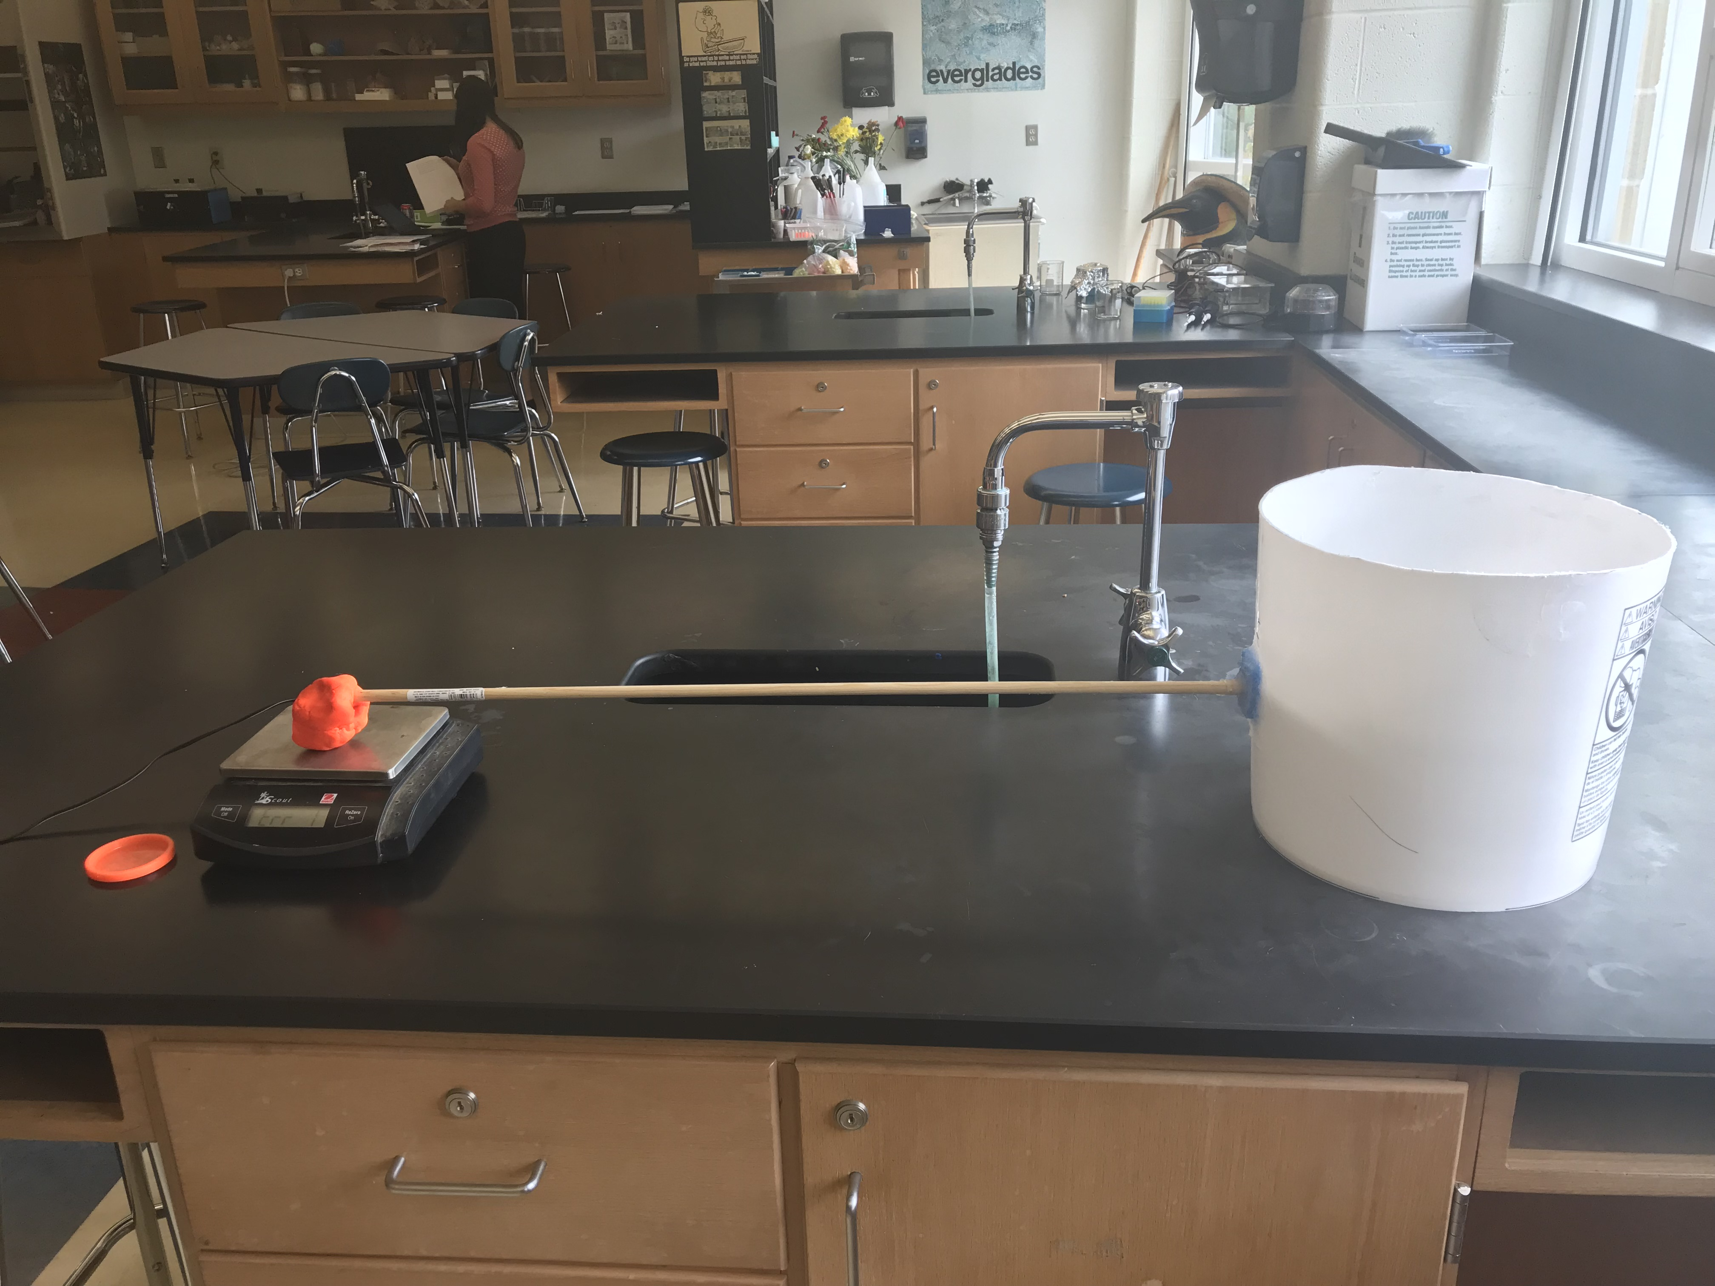
The Sensafloat

Slide 14
Cost analysis
Item | Website | Total | Unit Cost
Bucket | Horticulture | $1.16 | $1.16
Metal Pan | Webstaurantstore | $1.49 | $1.49
Wooden dowell | Amazon | $3.49 | $0.003
Scale | Webstaurantstore | $24.99 | $24.99
Playdoh | Target | $5.00 | $0.63
Loctite Clear Silicone Waterproof Sealant | Amazon | $4.28 | $4.28
Foam Pool Noodle | Mills Fleet Farm | $1.99 | $0.63
Hard Foam | Michaels | $4.99 | $4.99
Total cost: $38.18
Notes:
Hadley: say how we determined the total cost, (found items, determined the price per unit by taking the total cost and dividing it by the number of items in bulk, and then added them together)
We need to see how much we woiuld actually spend (38.18)
We need to rersesrvh cost of standard toilet, say this cost and tell buyers to add our price to toilet

Slide 15
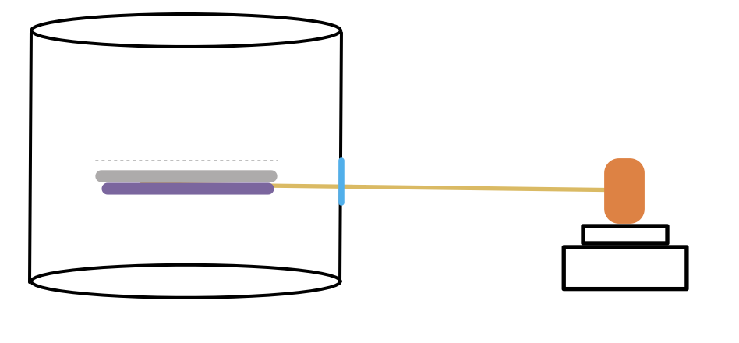
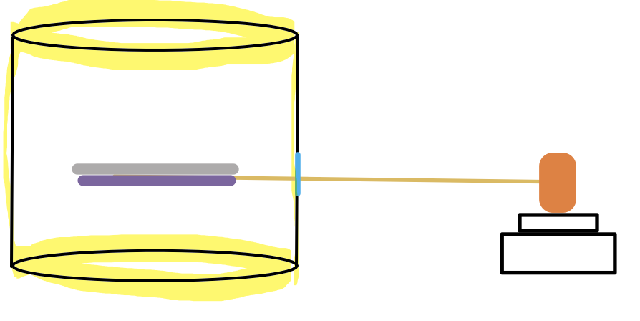
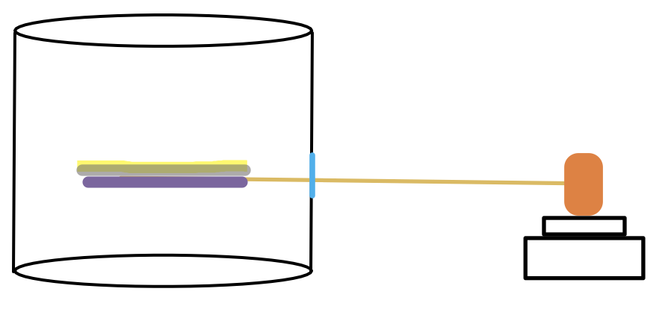
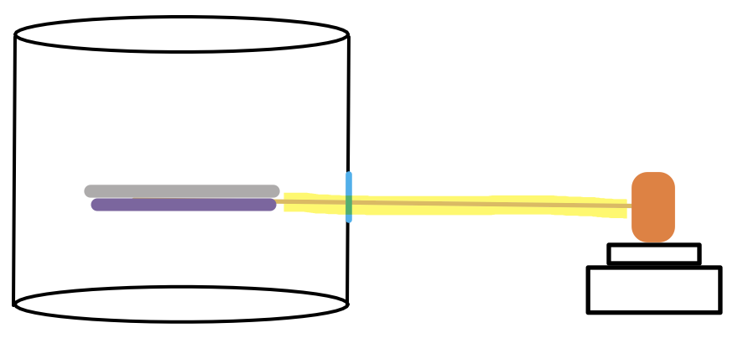
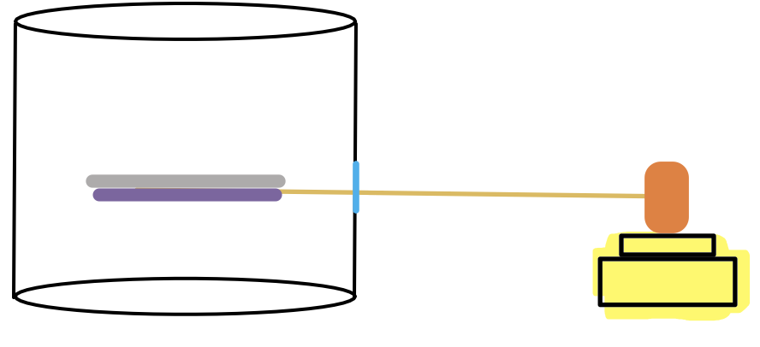
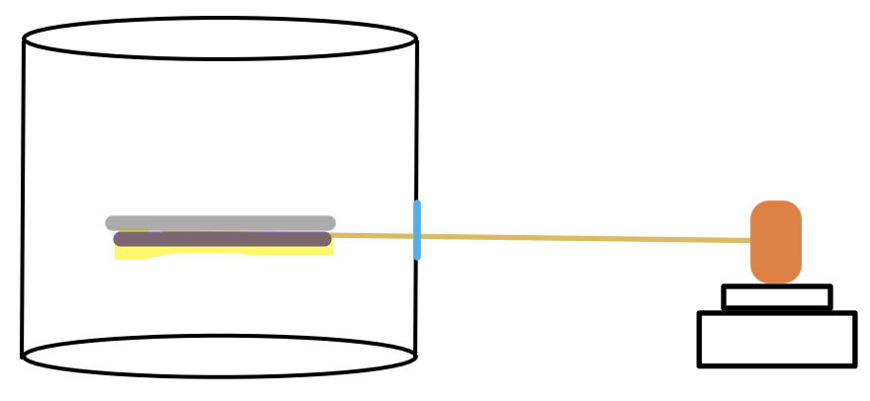
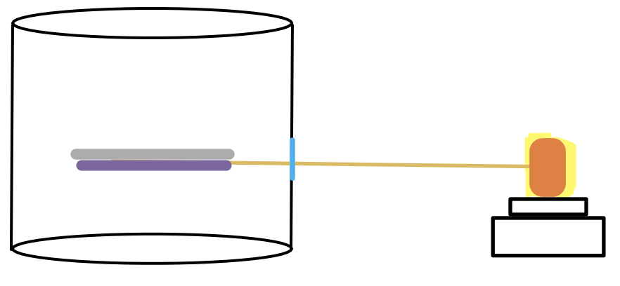
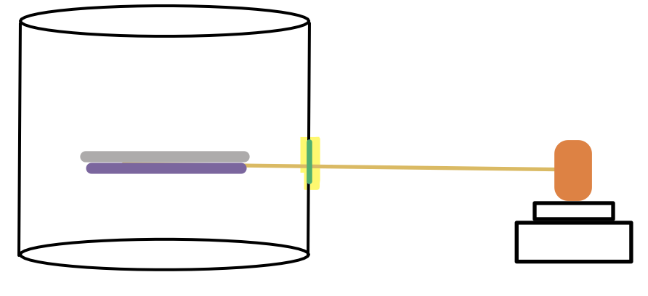
Description and Justification for Our Product
Bucket: base of structure which holds all the crucial materials within it, serves as the general structure for the “pipe”
Metal pan: attached to the foam provides the foam a stable surface to be pushed against so foam floats properly.
Wooden Dowell: applies the pressure from the added water to the scale in order to determine the type of waste, and the amount of water to properly flush it.
Scale: When pressure is applied from the wooden stick on to the playdoh, the scale reflects the change in water due to the added waste.
Playdoh: keeps the wooden stick connected to the metal pan, allowing for the waste to be appropriately weighed
Pool Noodle: plugs the hole in the bucket to avoid water leakage but allows for the wooden stick to go through the bucket
Hard Foam Circle: is attached under the metal pan, allowing the pan to float up with the added weight of waste
Loctite Clear Silicone Waterproof Sealant: seals the pool noodle filled hole in the bucket, allowing for more movability of the wooden stick while avoiding water leakage.
Total cost: $63.98
Notes:
hadley

Slide 16
Creation of Our product
Cut off 11cm top of a 37cm tall bucket.
Create a 3x4cm opening 15cm from the bottom of the bucket using a Dremel.
Cut out a flat 4x5cm piece out of the pool noodle and create a 1x1cm X in the center of the cut out
Cut 1cm deep slit into the middle of each side of the pool noodle.
Slide the pool noodle cut out inside the opening in the bucket and secure its sides around the bucket. Use the Loctite clear silicone waterproof sealant around the edge of the pool noodle on both the inside and outside of the bucket
Cut a circle out of a metal pan that has a diameter of 14cm using a metal cutter.
Cut a circle out of a hard piece of foam that has a diameter of 13cm and hot glue it to the bottom of the metal pan.
Place pan in the bucket.
Attach the wooden stick to the middle of the bottom of the cut out foam part of the pan using hot glue.
Stick the wooden stick through the hole in the bucket.
Use all of the 3 ounce can of playdoh and shape into a ball.
Attach ball of playdoh onto end of wooden stick that is outside the bucket.
Attach playdoh and stick to scale located besides bucket and smash playdoh onto the scale to secure the wooden stick onto the scale.
Notes:
Hadley (gist)

Slide 17
Styrofoam Testing results (add tables for other data)
Liquid Waste Data Table
Trials | Amount Added (mL) | Time for final mass change (s) | Change in mass (g)
1 | 300 | 12.78 | 22.7
2 | 300 | 15.90 | 21.8
3 | 300 | 11.43 | 21.9
Solid Waste Data Table
Trials | Amount Added (g) | Time for final mass change (s) | Change in mass (g)
1 | 300 | 1.95 | 3.6
2 | 300 | 2.47 | 3.3
3 | 300 | 2.04 | 3.5
Notes:
This is original test with our product, we used these values to come up with this graph,if you want to see the raw datat table, please reference our appendix (add graphs with line of best fits)
Explanation:
The data we collected was successful because as we added the model waste into the pipe, the mass increased drastically suggesting that the sensor floated. Also there was a major difference between the data recorded for the solid and liquid waste.
LiquidL the average change in mass was greater than the solid, because 300 ml of water takes up more volume than the 300 gram weight, therefore pushing the float higher which would then place more pressure on the scale thus causing a greater mass change.
The liquid took a longer time bc it was gradually poured, while for the solid waster was dispensed all at once

Slide 18
Which equations and why?

Slide 19
Future plans/Conclusion
Using our data, to create an algorithm that will be used by our sensor to determine the exact amount of water that is necessary for sanitation of the removal of the waste
Create a way for the solid waste to be directed around the Sensafloat during flushing
To conduct more research and testing on the different amounts and consistencies of waste
Research and decide the size the sensafloat will actually be inside the piping of the toilet
Notes:
amber

Slide 20
Citations
Alliance for Water Efficiency (Ed.). (n.d.). Toliets [Fact sheet]. Retrieved from Home Water Works website: https://www.home-water-works.org/indoor-use/toilets
Santa Cruz Water Department. (n.d.). How Much Water Does Your Toilet Use? [Pamphlet]. Retrieved from http://www.cityofsantacruz.com/home/showdocument?id=3890
Regional Water Providers Consortium (Ed.). (n.d.). Toliet. Retrieved November 13, 2017, from Conserve H20 website:
http://www.conserveh2o.org/toilet-water-use
Notes:
hadley

