Slide 1
Trip to Mars Through Robot A4
By: Mia Henry and Lauryn Norris

Slide 2
Robot Configuration
Gears: 20 tooth one the wheel and 16 tooth on the gears
These gears were picked in order for the robot to traverse various surfaces slower in order for the programs to be stopped if there was an emergency.
Wheels: small/regular size wheels
These wheels were selected in order to the robot to travel over surfaces that may be harder to travel on with slimmer wheels (e.g. rough terrain)

Slide 3
Moving Forward
jjen
Program Overview

Slide 4
Moving Forward
Program Overview
This program is for going forward. The first block is connected to port b (right wheel of robot) and the second block is connected to port c (left wheel of robot). Both are in charge of the wheels moving forward. The third block is in charge of waiting until the amount of degrees the motor has turned that the robot was programed in order to complete the following steps. The fourth and fifth blocks are responsible for stopping the wheels and motors after the wait for block.

Slide 5
Moving Forward
Program Overview
This program is for going forward. The first block is connected to port b (right wheel of robot) and the second block is connected to port c (left wheel of robot). Both are in charge of the wheels moving forward. The third block is in charge of waiting until the amount of degrees the motor has turned that the robot was programed in order to complete the following steps. The fourth and fifth blocks are responsible for stopping the wheels and motors after the wait for block.

Slide 6
Moving Backward
Program Overview
This program is for going backward. The first block is connected to port b (right wheel of robot) and the second block is connected to port c (left wheel of robot). Both are in charge of the wheels moving backward. The third block is in charge of waiting until the amount of degrees the motor has turned that the robot was programed in order to complete the following steps. The fourth and fifth blocks are responsible for stopping the wheels and motors after the wait for block.

Slide 7
Moving Backward
Program Overview
This program is for going backward. The first block is connected to port b (right wheel of robot) and the second block is connected to port c (left wheel of robot). Both are in charge of the wheels moving backward. The third block is in charge of waiting until the amount of degrees the motor has turned that the robot was programed in order to complete the following steps. The fourth and fifth blocks are responsible for stopping the wheels and motors after the wait for block.

Slide 8
Turning
Program Overview
This program is in chare for turning to the left. In order to turn to the right, the motors must be switched. The robot is told to make motor B stationary while motor C, which is connected to the robot’s left wheel, to turn. After the motor has turned 360 degrees, the fourth block is designed to stop motor c connected to the left wheel. This program is important to have in order to turn in tight corners/areas.

Slide 9
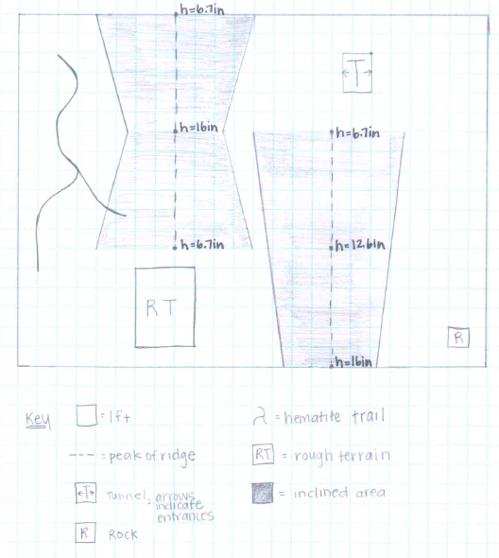
Diagram of Mars Landing Site

Slide 10
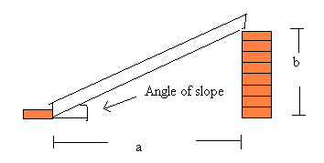
Inclining and Declining Slopes
While our robot went up and down various slopes, our program sent the robot traveling backward but slowly to prevent the robot from falling over

Slide 11
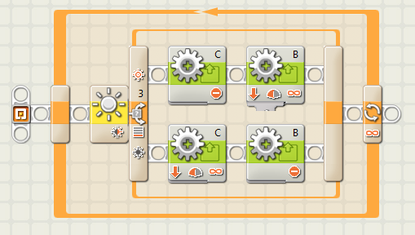
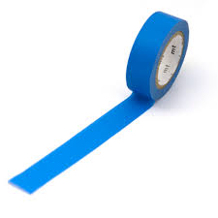
Traveling the Hematite
For the surface of the hematite trail, we programmed our robot to travel forward and slowly, but not to slow so it can detect the line correctly.

Slide 12
Traversing Various Surfaces: Rough Terrain and Mars Surface
Pebbles
We increased the power of the motor in order for the robot to travel not only faster but with more power. We would also want it to go backwards, and programed to go for a longer distance.
Mars Surface
We would be using the forward program and less power would be added to the program.

Slide 13
Test Stimulations
As the other person acted as the robot, the partner/ controller had to tell her programs in order for her to complete the task at hand (e.g. go forward one foot, turning 90 degrees to the right, etc.) This guided our way through the programming and gave us a sense in how to tackle to Mars quickly and efficiently.

Slide 14
References/ Citations
https://www.youtube.com/watch?v=ZvCI-gNK_y4
http://www.sciencebuddies.org/science-fair-projects/project_ideas/CE_p022.shtml

