Slide 1
Created By: Mary Pate, Adele Spencer, Lauryn Norris, Mia Henry, Chris Robinson, and Autumn Johnson
Palm-D Sunscreen
By CLAAM©

Slide 2
We wanted a Sunscreen with:
Maximum SPF and LD50 value
Concerning levels of Oxy Cinnamate and Oxybenzone
Minimum final cost per unit
Find minimum costs of ingredients (sunscreen)
Costs of materials (packaging)
Maximum cost of package was $3.00 due to the use of hot glue
A durable and cheap package that withstands the 8 tests
Notes:
Autumn
Goal: Currently, our task is to create a sunscreen package that withstands the 7 tests (these will be mentioned later) containing the safest and effective formulated sunscreen (created by yours truly), both at the lowest cost possible.
Max LD50
An LD50 is a standard measurement of harmful effects that prevent success and development of a substance that result from either a single exposure or multiple exposures in a short period of time. This measurement is measured in milligrams (mg) of chemical per kilogram (kg) of body weight.
It is important that we have multiple LD50 tests, so we can make sure we are able to use the maximum amount of our active ingredients, in order to provide the best protective sunscreen without harming anyone.
Max SPF
SPF measures sunscreen protection from UVB rays, the kind that cause sunburn and contribute to skin cancer
Min Cost (packing and sunscreen)
Goal: (as mentioned earlier) create sunscreen and package with the least cost
Max cost of package

Slide 3
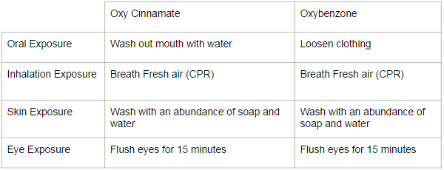
Overview of SDS Information
SDS → Safety Data Sheet
Oxy Cinnamate: http://www.elan-chemical.com/dev/msdspdf/ETHYL%20CINNAMATE.pdf
Oxybenzone: http://www.sciencelab.com/msds.php?msdsId=9926361
Notes:
Mary
Document containing important information on hazardous chemicals and the health and safety of them in an area.
Identify
Health and hazards
Manage safely
Emergency situations
Dispose

Slide 4
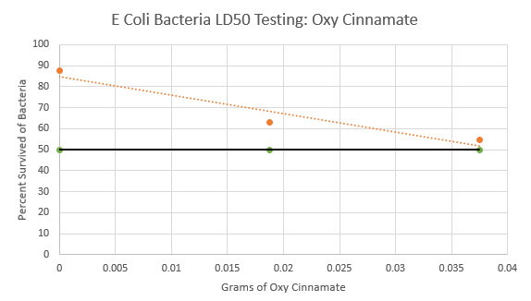
LD50 data: Oxy Cinnamate (E Coli)
Notes:
Mary

Slide 5
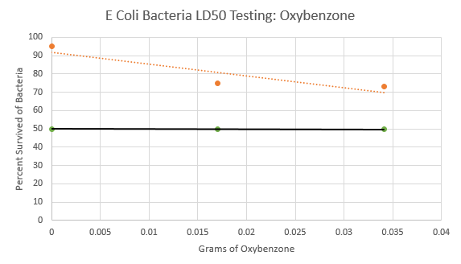
LD50 data: Oxybenzone (E Coli)
Notes:
Mary

Slide 6
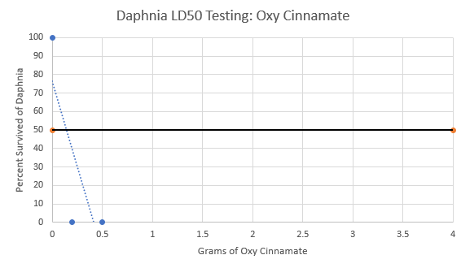
LD50 data: Oxy Cinnamate (Daphnia)
Notes:
Mary

Slide 7
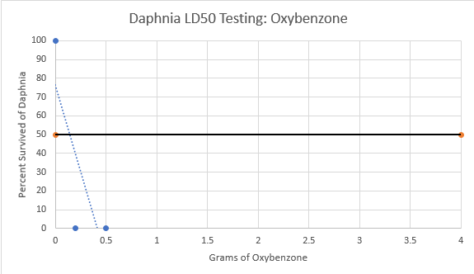
LD50 data: Oxybenzone (Daphnia)
Notes:
Mary

Slide 8
LD50 data: Oxybenzone and Oxy Cinnamate (Human)
Trial | Oxybenzone | Oxy Cinnamate | Results
Legal Amounts | 5.28 grams | 6.6 grams | Did not test this amount
Trial #1 (50%) | 2.64 grams | 3.3 grams | No pain or irritation
Trial #2 (75%) | 3.96 grams | 4.95 grams | No pain, skin became red
Trial #3 (66.66%) | 3.52 grams | 4.4 grams | No pain or irritation

Slide 9
Conclusions From LD50
Through our multiple trials on the E-Coli, Daphnia, and Human, we decided to use 66.6% of the legal amounts of both the Oxybenzone (3.52 grams) and the Oxy Cinnamate (4.4 grams).
Notes:
Mary

Slide 10
Analysis of Sunscreen Materials
Substance | Amount of grams used
Cetyl Alcohol | 2.0 grams
Oxybenzone | 3.52 grams
Oxy Cinnamate | 4.4 grams
Steric Acid | 4.0 grams
Glycerin | 2.0 grams
Trethanol Amine | 1.0 grams
Water, Distilled | 78.0 grams
Source
alibaba
Alibaba
Alibaba
chemistryconnection
bolkapothecary
bonanza
coxhardwire
Cost per gram
$0.0012
$0.002
$0.005
$0.005
$0.0031
$0.04
$0.0004
Total cost
$0.0024
$0.007
$0.022
$0.02
$0.0062
$0.04
$0.0312
Total Unit Cost for Chemicals: $0.13
Notes:
Autumn

Slide 11
Material Testing Data
Material | Drop | Shake | Weight | Throw | Water | Heat | Overall Average
Newspaper
Cardboard
Plastic Bag
Plastic Wrap
Foil
Wax Paper
Duct Tape
Masking Tape
3 | 3 | 2 | 3 | 1.5 | 3 | 2.58
3 | 3 | 1.5 | 2.5 | 1.75 | 3 | 2.46
3 | 3 | 3 | 3 | 3 | 3 | 3
2 | 2.5 | 2 | 2 | 3 | 3 | 2.42
2.5 | 2 | 2 | 2 | 3 | 3 | 2.42
3 | 2.5 | 2 | 2 | 3 | 3 | 2.58
3 | 3 | 3 | 3 | 2.5 | 3 | 2.92
2.5 | 3 | 2 | 2.5 | 1.5 | 2 | 2.25
Notes:
Lauryn
Averages - done
Scale: 0 is worst and 3 is best

Slide 12
Package #1
Notes:
Lauryn

Slide 13
Package #1 Testing Data
Trial | Drop | Shake | Weight | Throw | Water | Heat
1 | 2.8 | N/A* | N/A* | N/A* | 2 | N/A*
2 | 2 | N/A* | N/A* | N/A* | 1.5 | N/A*
3 | 1 | N/A* | N/A* | N/A* | 1 | N/A*
Average | 1.93 | N/A* | N/A* | N/A* | 1.5 | N/A*
N/A* - Not Applicable; not worth proceeding after throw test because the throw test severely damaged the package.
Notes:
Lauryn

Slide 14
Package #2
Notes:
Adele
Justifications
Cardboard
Plastics bags
Wax Paper
Hot Glue

Slide 15
Package #2 Testing Data
Trial | Drop | Shake | Weight | Throw | Water | Heat | Total
1 | 3 | 3 | 3 | 3 | 3 | 3
2 | 3 | 3 | 3 | 3 | 2.7 | N/A*
3 | 2.8 | 3 | 2.7 | 3 | 2.5 | N/A*
Average | 2.9 | 3 | 2.9 | 3 | 2.73 | N/A* | 2.91
N/A* - Not available because for heat test only 1 trial was necessary
Notes:
Lauryn

Slide 16
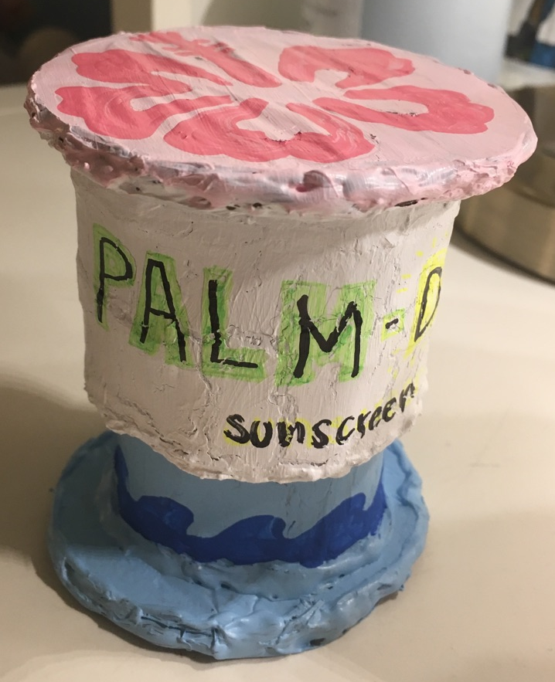
Final Package

Slide 17
Final Package Testing Data
Trial | Drop | Shake | Weight | Throw | Water | Total
1 | 3 | 3 | 3 | 3 | 3
2 | 3 | 3 | 3 | 3 | 2.7
3 | 3 | 3 | 3 | 2.9 | 2.5
Average | 3 | 3 | 3 | 2.9 | 2.73 | 2.93
N/A* - Not available because for heat test only 1 trial was necessary
Notes:
Lauryn

Slide 18
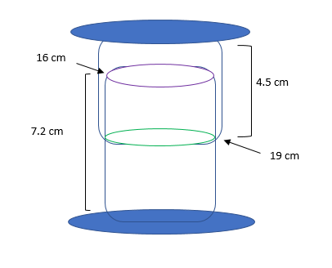
Creation Process and Dimensions of Final Package
Two cylinders that fit snugly together from cardboard
Coated inside of cylinders with plastic bag and outside of cylinders with wax paper
Two supporting circles (top & base)
Coated inside of circles with plastic baggie and outside with wax paper
Insulated any cracks or openings with hot glue
Notes:
Adele

Slide 19
Cost of Final Package
Materials | Cost per specific material | Amount of specific material
Cardboard Square | $1.00 | 1 square
Plastic Bag | $0.25 | 1 bag
Wax Paper (30 x 15 cm) | $0.50 | 1 piece
Total Package Cost: $1.75
Maximum cost with hot glue = $3 - No restriction on hot glue*
Notes:
Adele

Slide 20
Total Cost of Palm-D Sunscreen
Material | Cost
Chemicals | $0.13
Package | $1.75
Total Unit Cost: $1.88
Notes:
Adele

Slide 21
Why choose Palm-D?
Notes:
Adele

Slide 22
It’s Affordable!
Palm-D only costs $1.88

Slide 23
It’s Protective!
Palm-D sunscreen uses 66.6% of the legal amounts of the SPF determining chemicals, making our SPF value 16

Slide 24
It’s Environmentally Safe!
The Cardboard is recyclable
The Plastic Bag interior is recyclable
The Wax Paper (soybean based) is compostable
The Hot Glue (thermoplastic) is recyclable
https://www.woonsocketri.org/sites/woonsocketri/files/bulletins/recycling_1.jpg

Slide 25
It’s Beautiful!

Slide 26
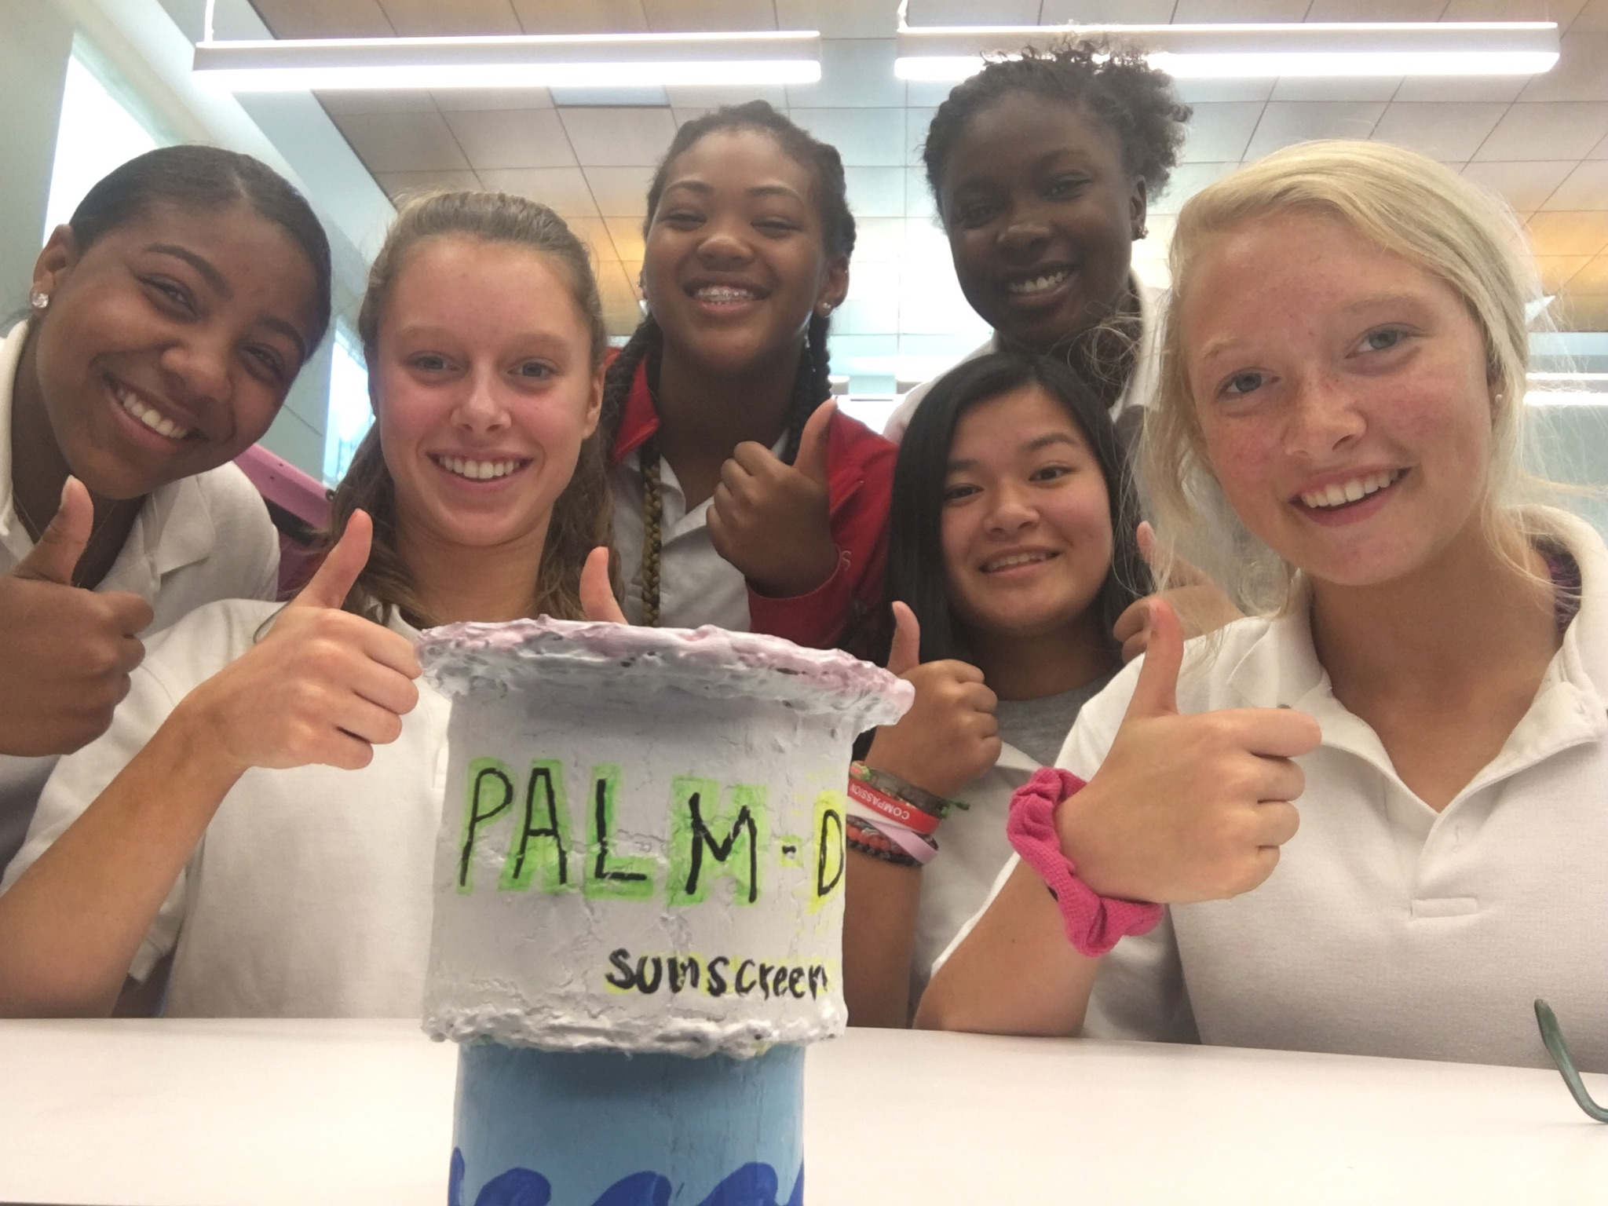
Thank You Questions?
Notes:
Adele

